Slide 1

MEET THE POTENTIAL

Slide 2

Boyko Atanasov
Chair of the Financial Supervision Commission

Slide 3
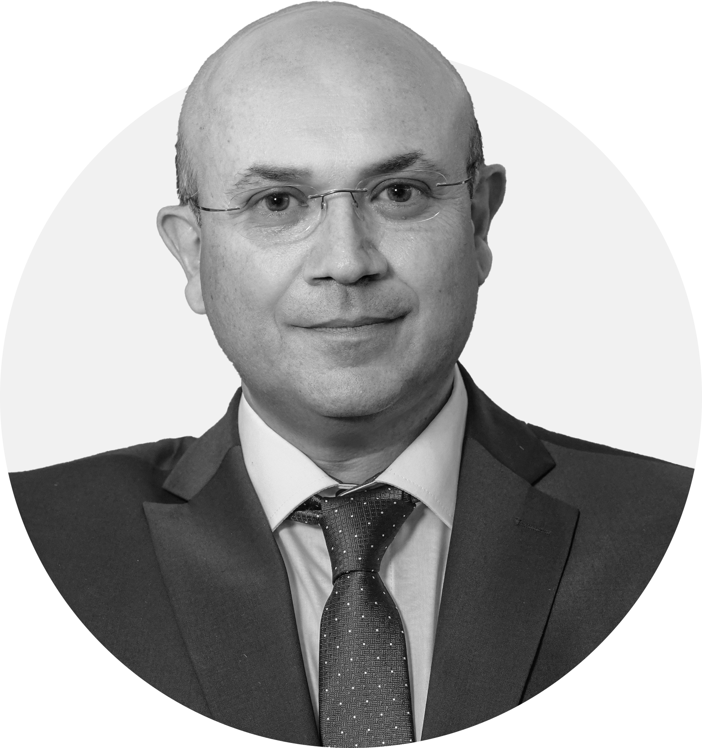
Manyu Moravenov
CEO of Bulgarian Stock Exchange

Slide 4
Bulgarian Stock Exchange Group
Bulgarian Stock Exchange Group
Subsidiaries
Associates
Joint ventures
Independent Bulgarian Energy Exchange
100% BSE
ClearEX AD
40% BSE / 60% CSD
SEE Link AD, Skopje
33.33% BSE
Financial Market Services EOOD
100% BSE
BD Consults AD
42.50% CSD
33 % Clear EX AD
24.50% BSE
Collective Financing AD
49% BSE / 32% CSD /
19% Clear EX AD

Slide 5
BSE Trading data

Slide 6

BSE Trading data

Slide 7
Investor data
76% growth in investment fund assets for the last 3 years;
30% growth in pension fund assets for the last 3 years.
More than 11,000 new investors for the last 3 years;
32% of the new individual investors in 2023.

Slide 8
BSE Projects & Initiatives

Slide 9











































































beamUpLab - Companies
Partners
Advisors
Companies

Slide 10

















beam - Success stories
17
Over EUR 27 mln.
Listed companies
Raised capital
4
Over EUR 56 mln.
Companies at maximum funding threshold
Investors demand
BeamX Index

Slide 11








Green Finance & Energy Centre - Participants
49 Participants as of April, 2024
BSE and IBEX
2
Business /
incl. Banks
20
State institutions
– Partners
5
Academia
4
NGOs
9
Consultants
9

Slide 12



Green Finance & Energy Centre - Activity of the Centre
ESG Guidelines
Seminars
and Trainings
Knowledge Hub
Green Talks

Slide 13




Variety of Tools
STOCK
LENDING PLATFORM
Licensed with GRI technology-based reporting platform with built-in emission calculator intended for both public and private companies to assess the impact of their business across leading ESG metrics
Integrated system for information disclosure by the public companies and other issuers of securities
Specialized media, intended for public companies and other issuers of securities to disclose regulated information to the public
Electronic platform providing structured financial data and news on all Bulgarian public companies and intended individual and institutional investors, analysts and data providers, issuers, state institutions, as well as media
Automated stock lending platform intended to facilitate stock lenders (e. g. holders of large portfolios of securities) and borrowers (e.g. counterparties in short selling transactions)

Slide 14
BSE Approach to Sustainability
ESG Index
Bulgarian public companies will receive ESG scores by LSEG D&A
Companies with the highest ESG scores will be selected for index constituents
Approved methodology for calculation of an ESG index
Official launch of the index in June 2024

Slide 15
Deutsche Börse & BSE

Slide 16

More than 15 years successful cooperation (1/2)
Long-standing partnership
Trading and surveillance infrastructure - Т7® & Observer
Index calculation services –
Market data distribution – CEF®
Markets development – EuroBridge Market& BSE International

Slide 17
More than 15 years successful cooperation (2/2)
MTF BSE International
Access to nearly 400 top global companies and ETFs;
Narrow bid-ask spreads by Tradegate as a market market;
10% weight of the BSE's total trading for 2023;
Top 10 companies – 64% from the total turnover on BSE International;
Opportunities for further increase in turnover after transferring instruments from MTF to the regulated market;

Slide 18


EuroBridge Market (1/2)
Global institutional investors
One procedure and one listing fee
Bulgarian investors
Key Features:
Т7®
FSE Xetra
Bulgarian public company
EuroBridge Market
Trading Platform – Xetra T7® (Bulgaria; Germany);
Market Model - Continuous trading (Bulgaria; Germany);
Trading Currency - EUR (Bulgaria; Germany);
Handling of corporate actions in EUR (Bulgaria; Germany);
Unified listing and ongoing transparency requirements applicable for all EU-regulated markets (Bulgaria; Germany);
Listed
Listed
CCP-eligibility
FSE Xetra additional requirements :
Designated sponsor
BSE additional requirements:
Trading in EUR;
Handling of corporate actions in euro
Clearing
Settlement
Eurex Clearing

Slide 19





Key benefits
EuroBridge Market (2/2)
Enhanced credibility and visibility
Access to global capital
Market valuation and liquidity
Opportunities for global expansion or exit
Talent recruitment

Slide 20
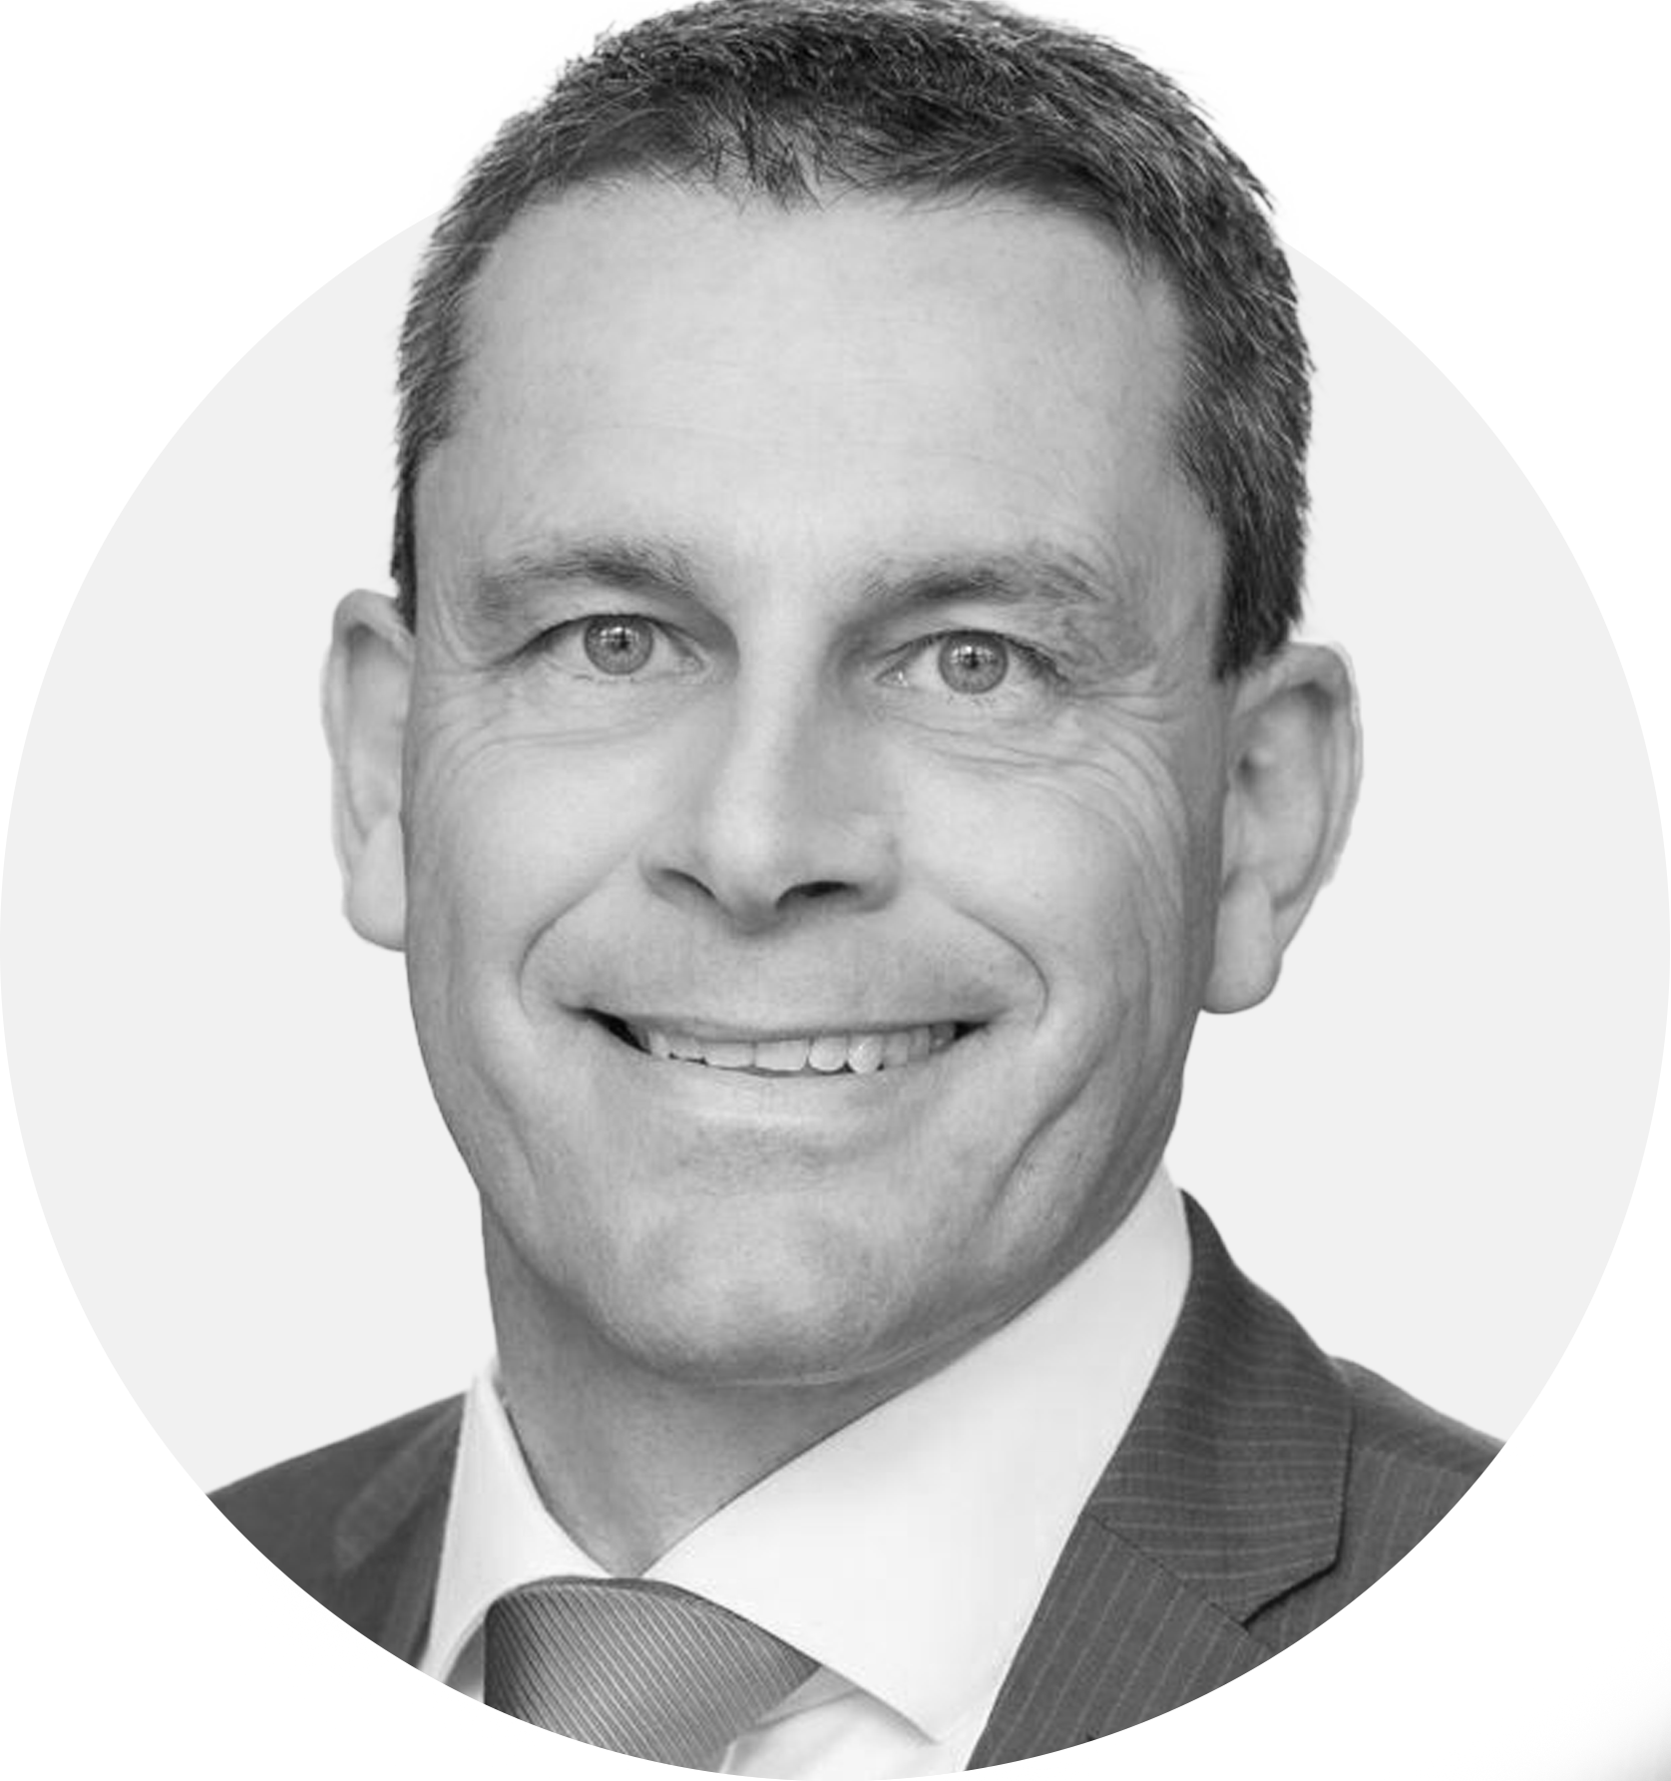
Michael Riess
IPO&Growth Financing, Deutsche Börse

Slide 21


Slide 22
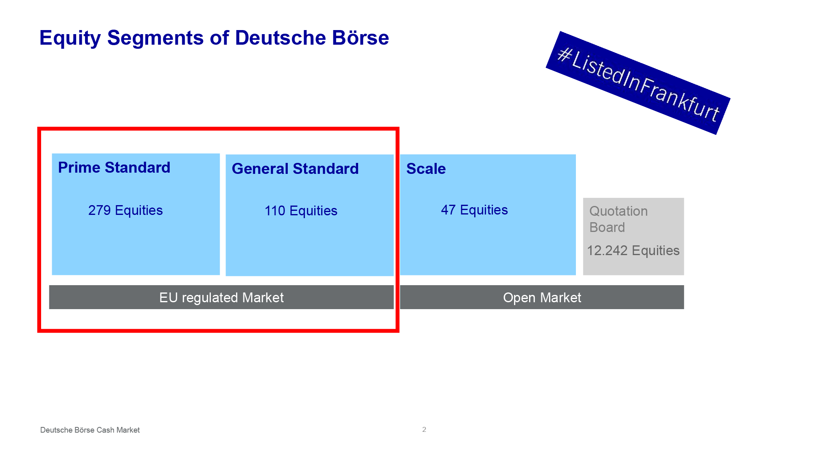

Slide 23
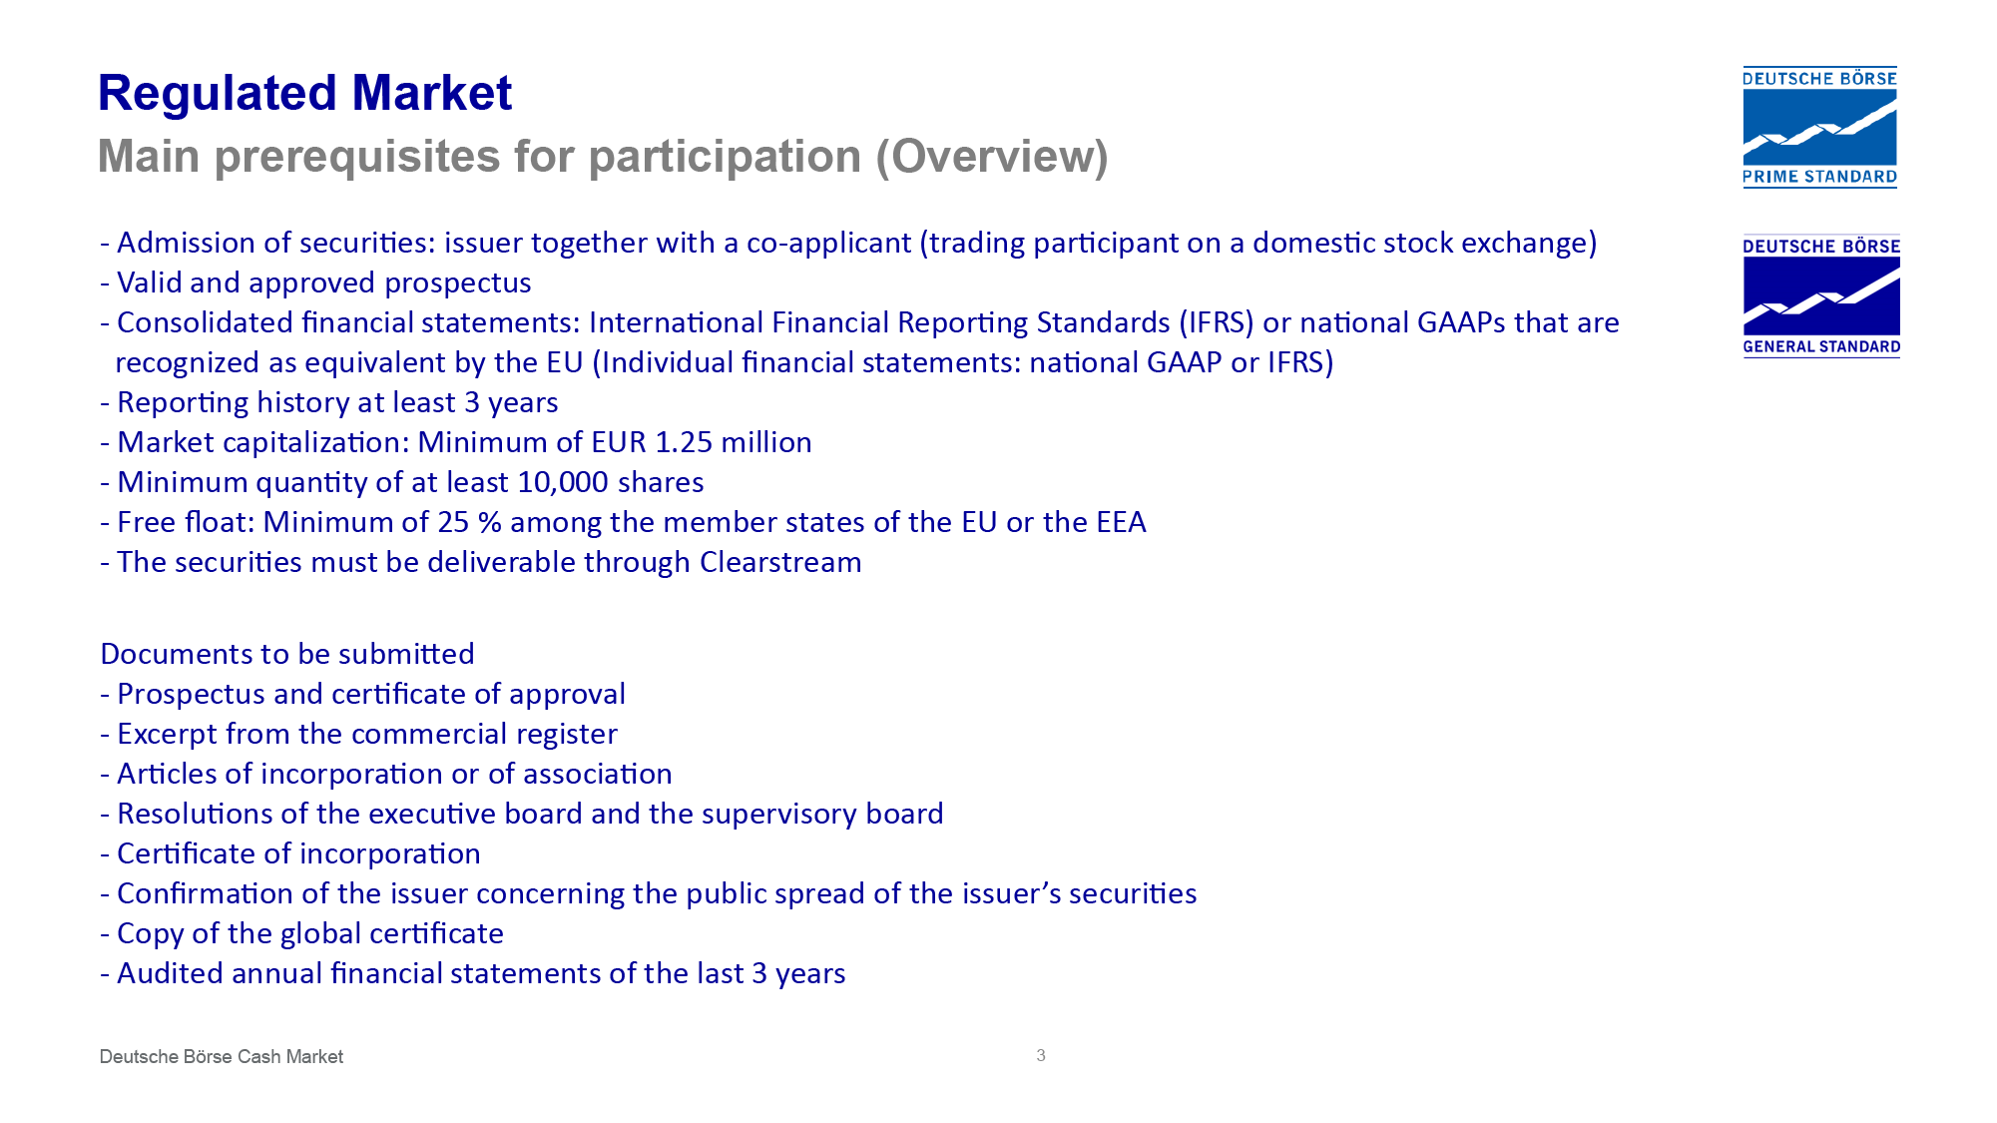

Slide 24
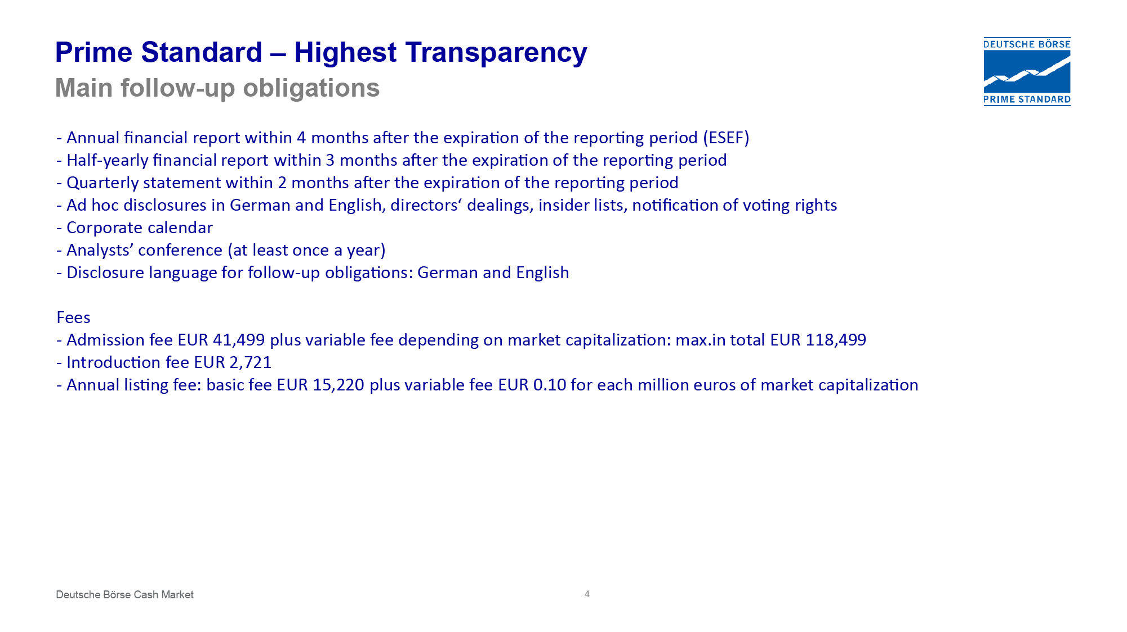

Slide 25
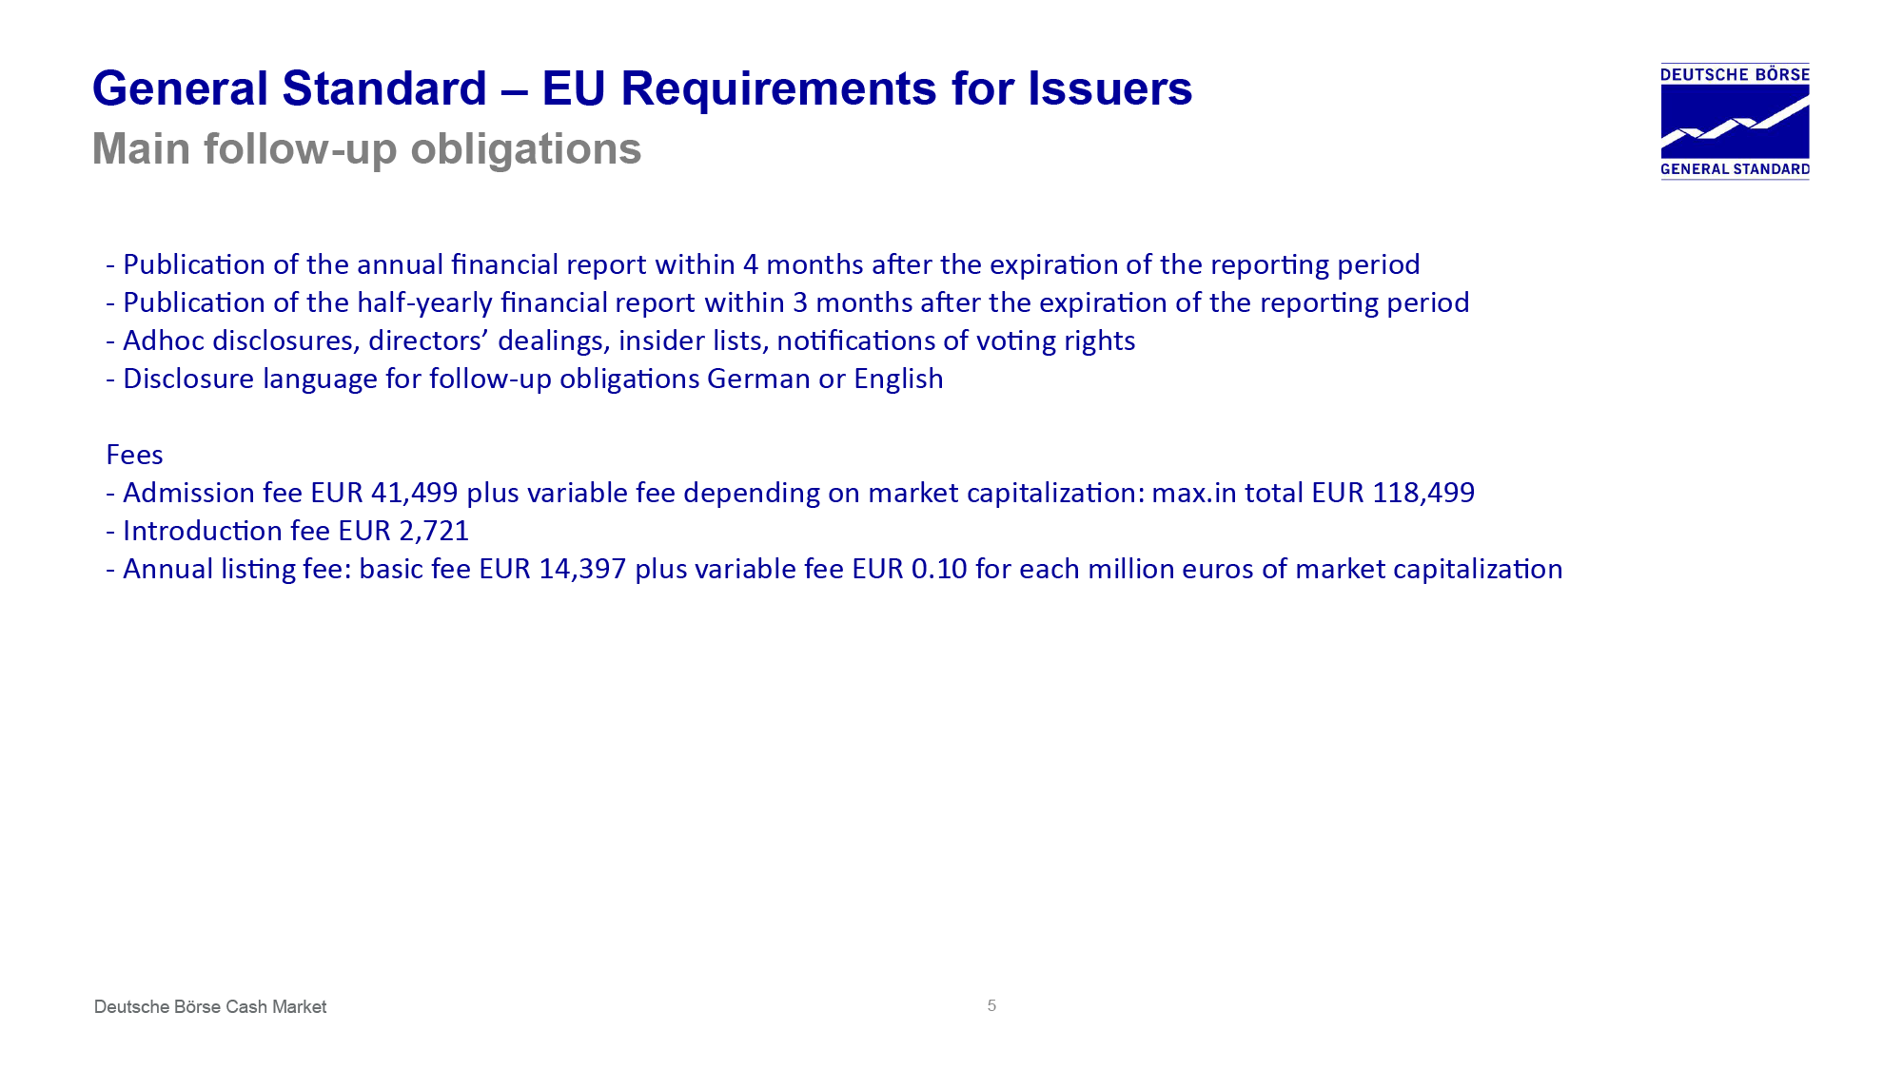

Slide 26
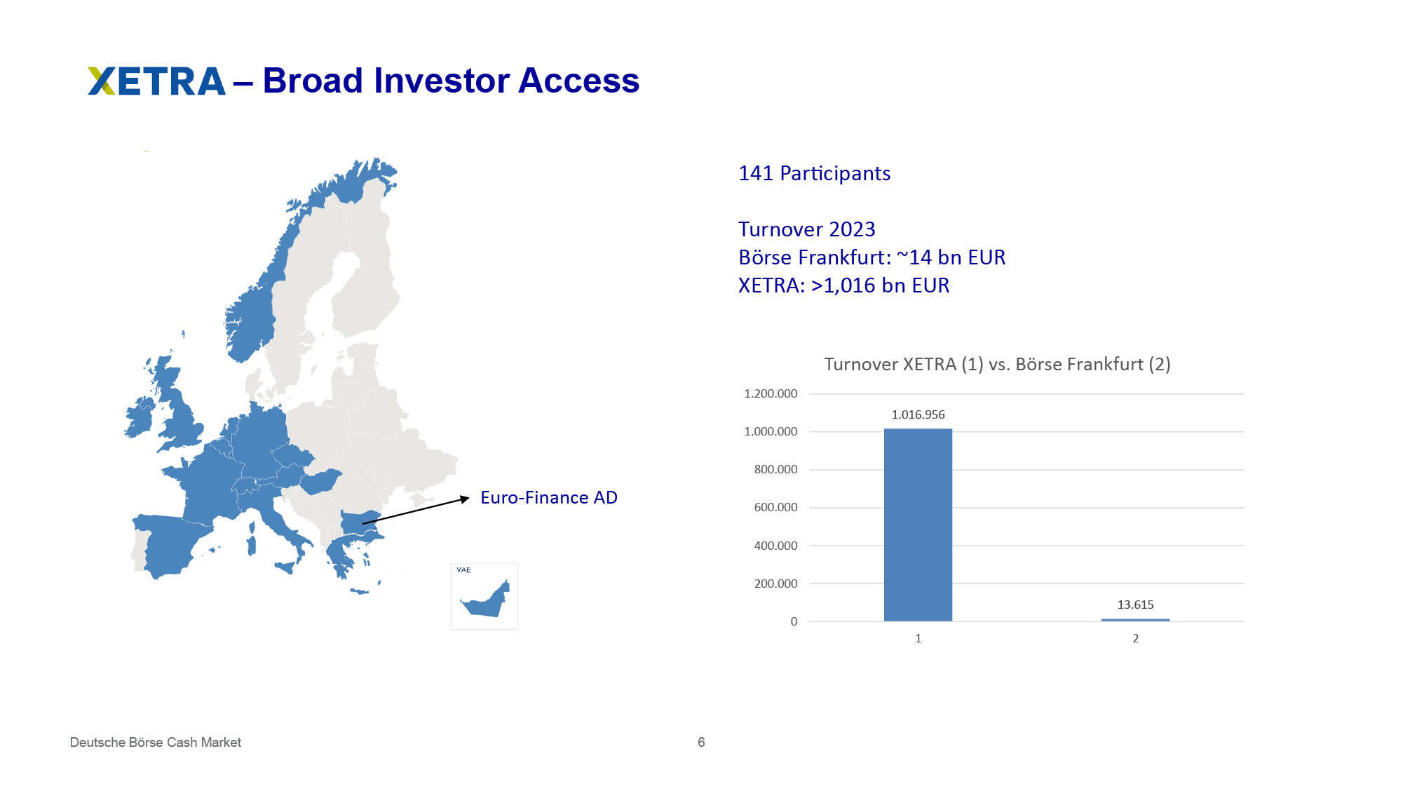

Slide 27


Slide 28
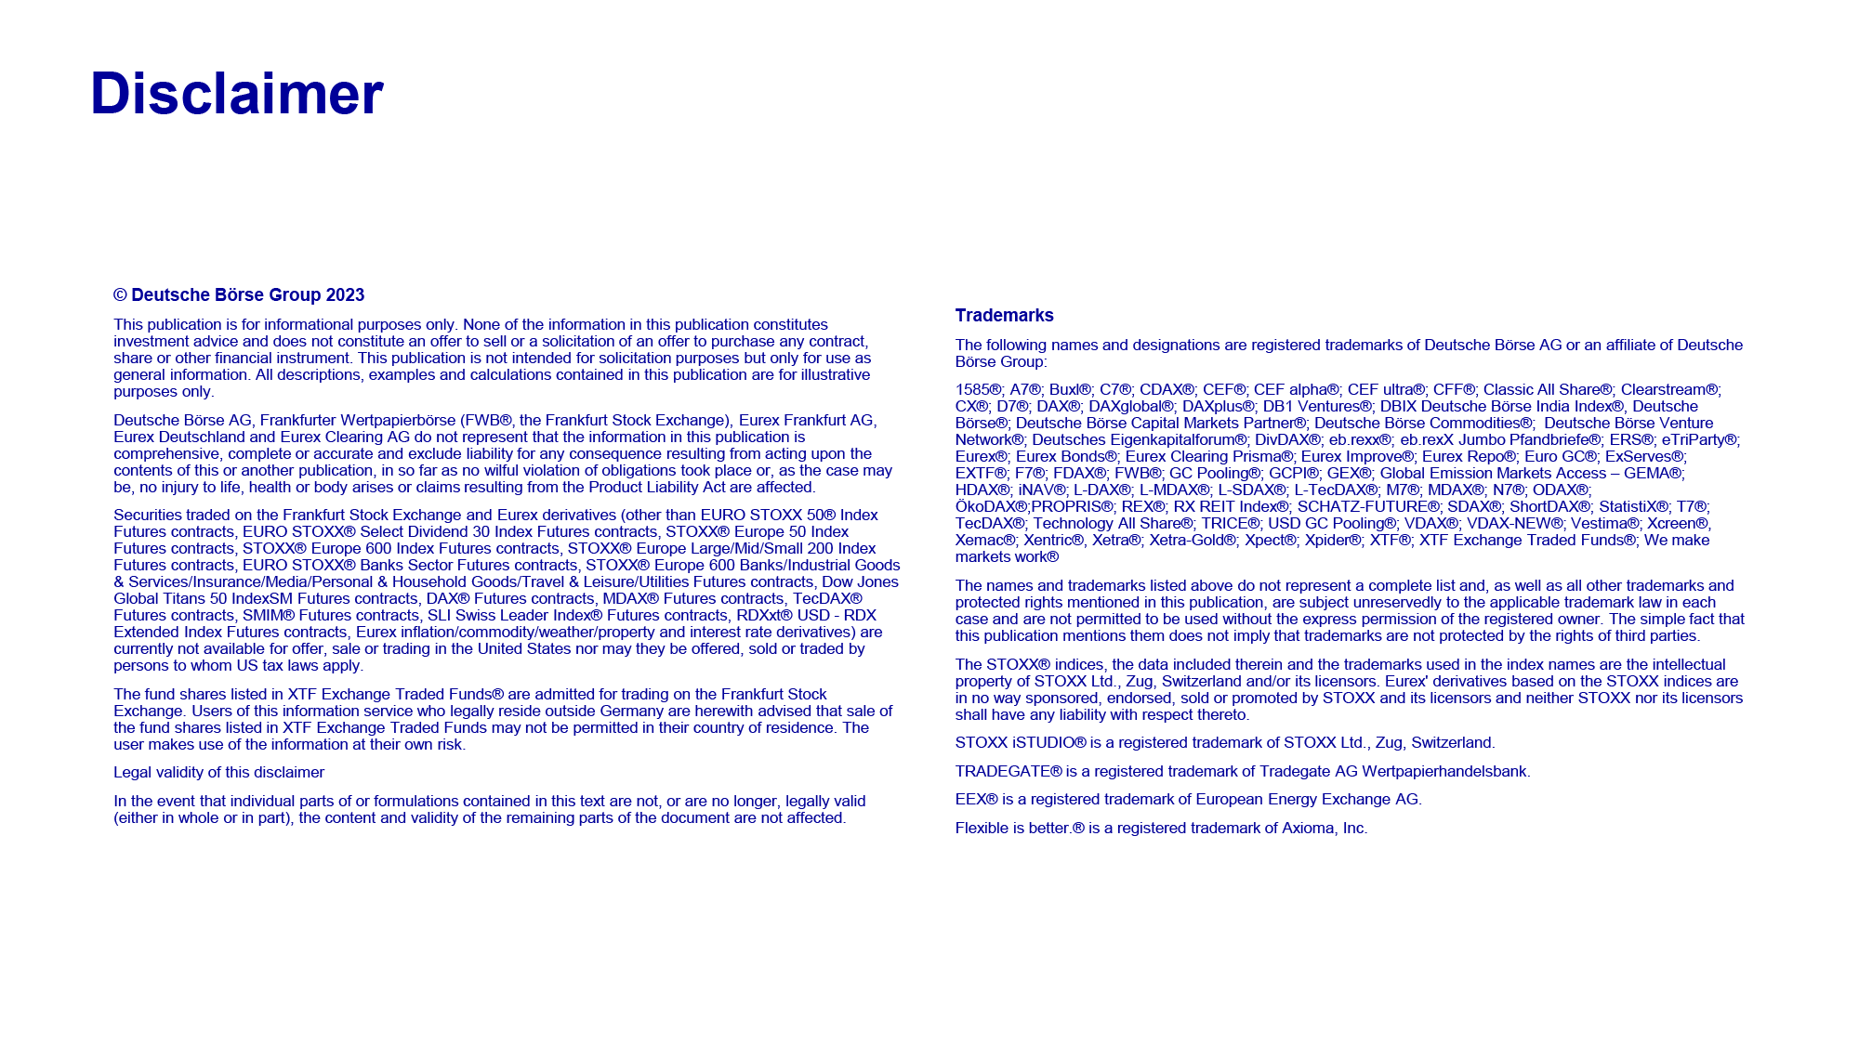

Slide 29
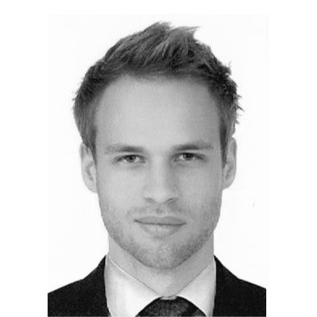

Raphael Sülzle
Corporate Brokerage, Baader Bank

Slide 30
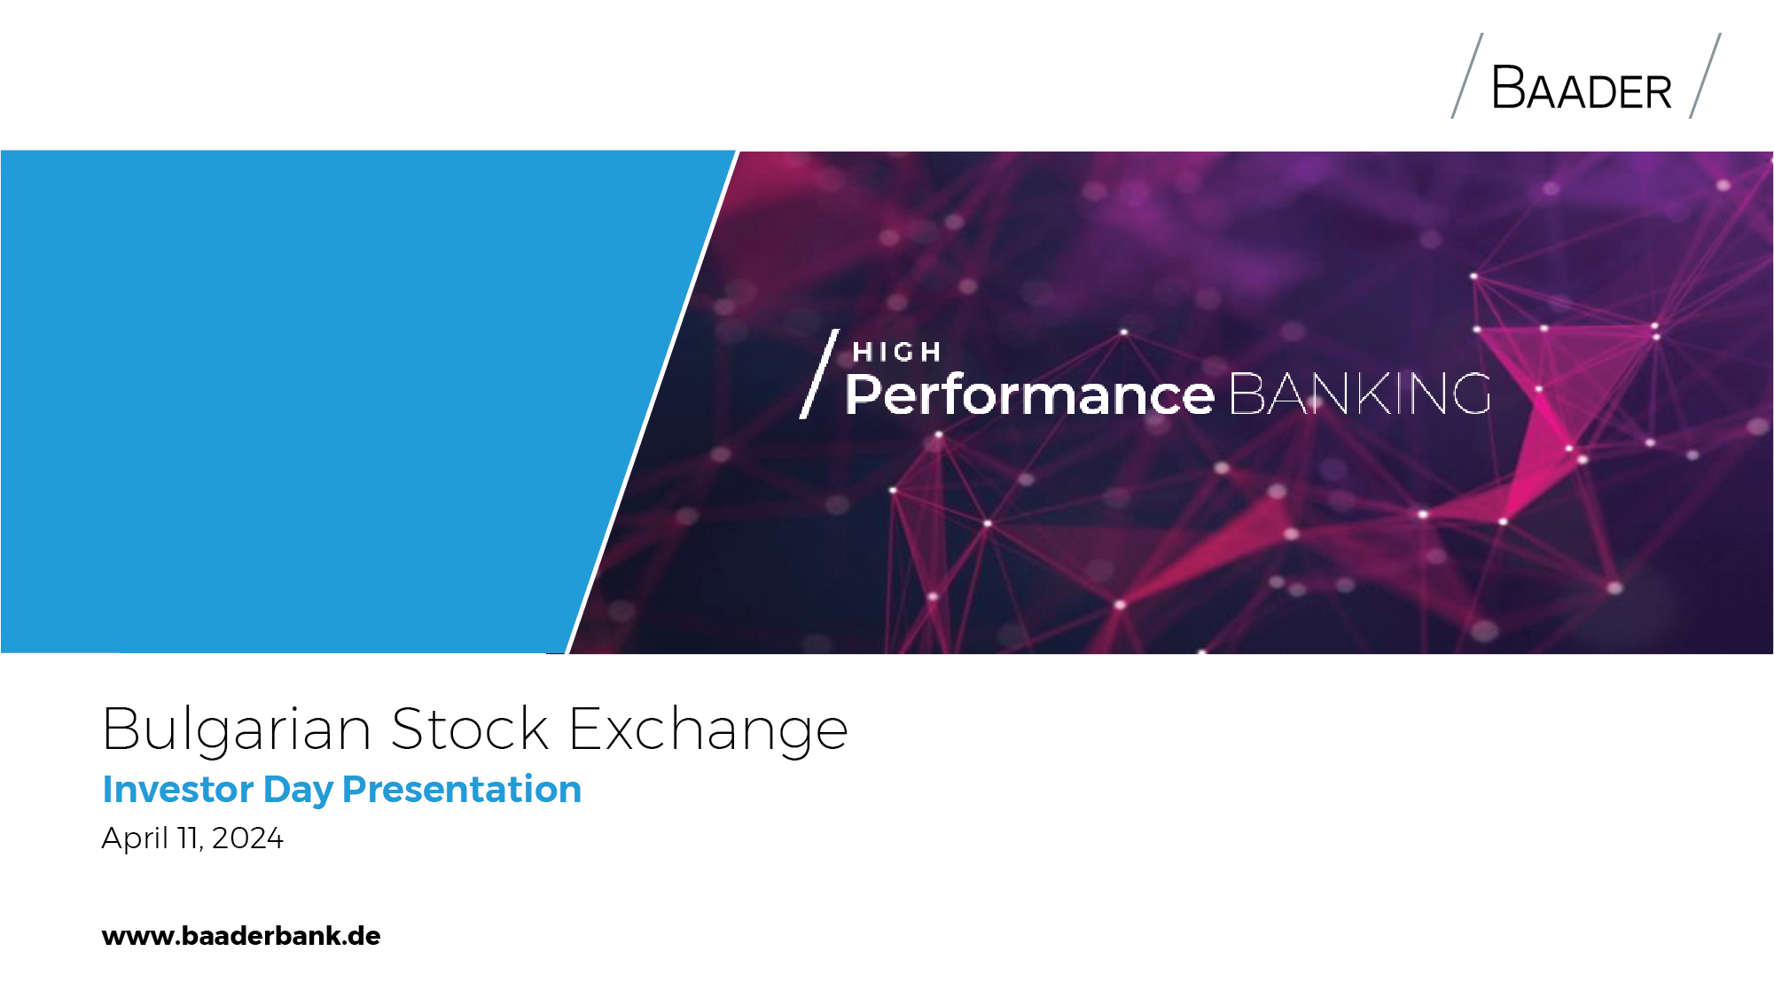

Slide 31


Slide 32
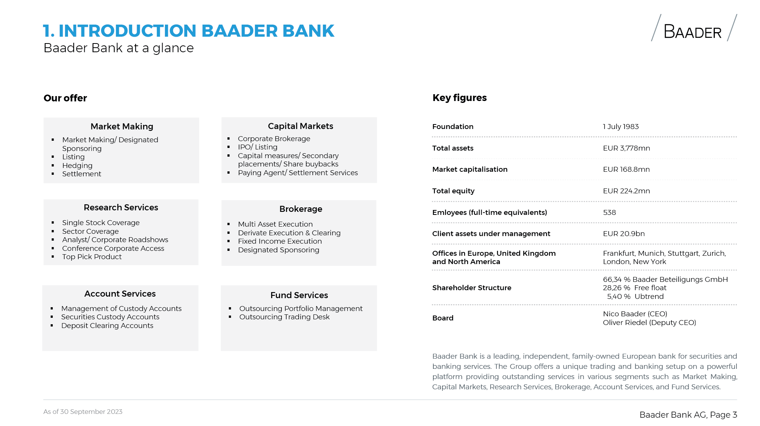

Slide 33
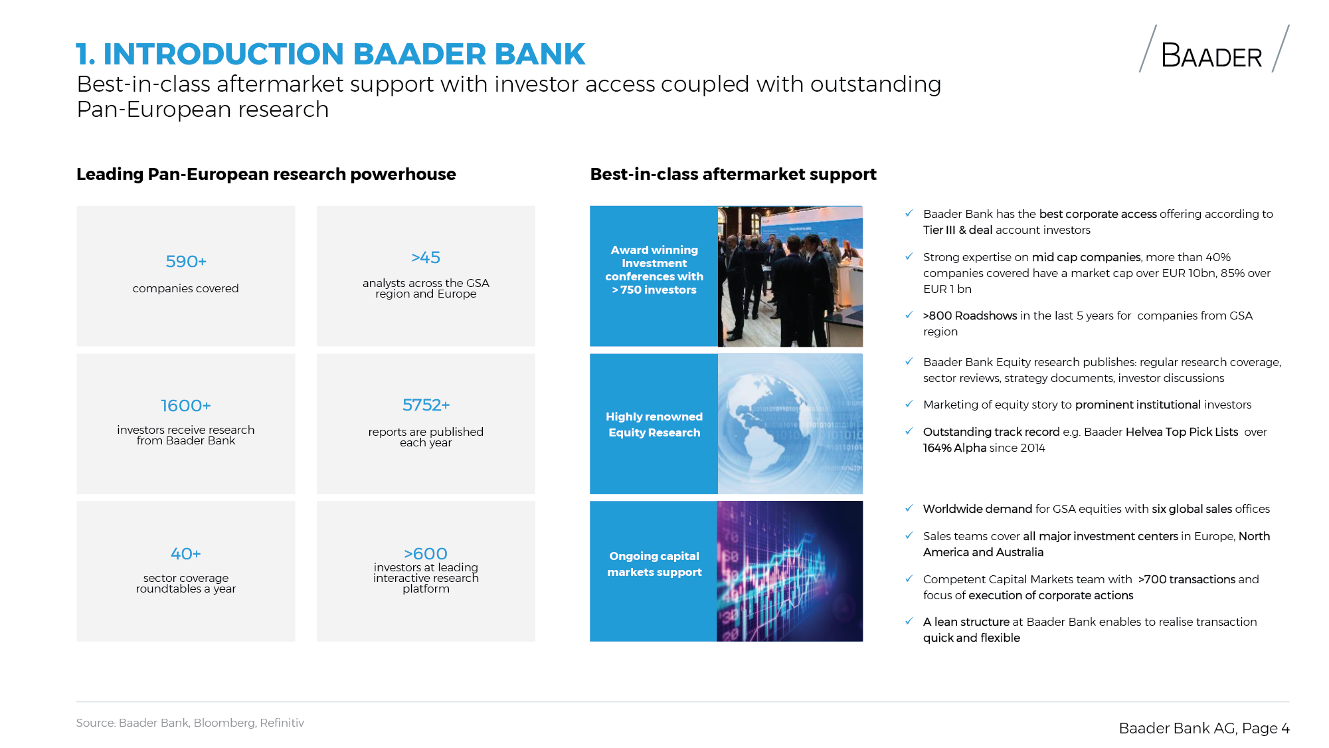

Slide 34


Slide 35
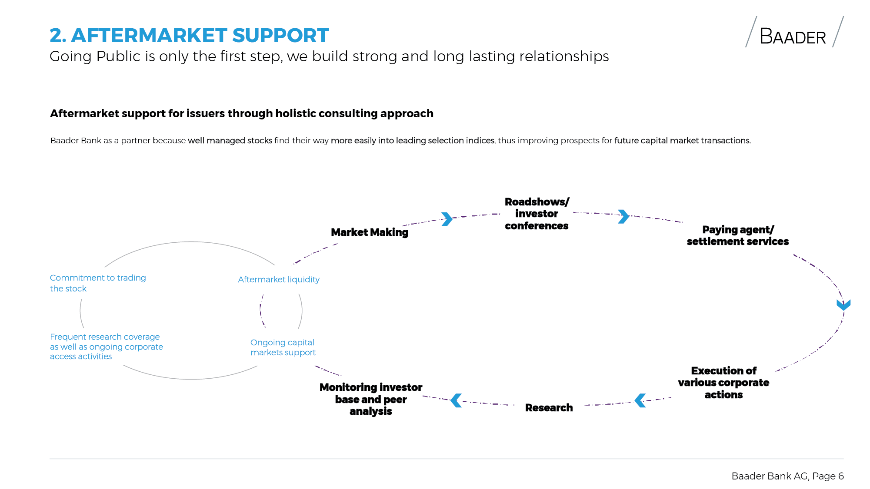

Slide 36
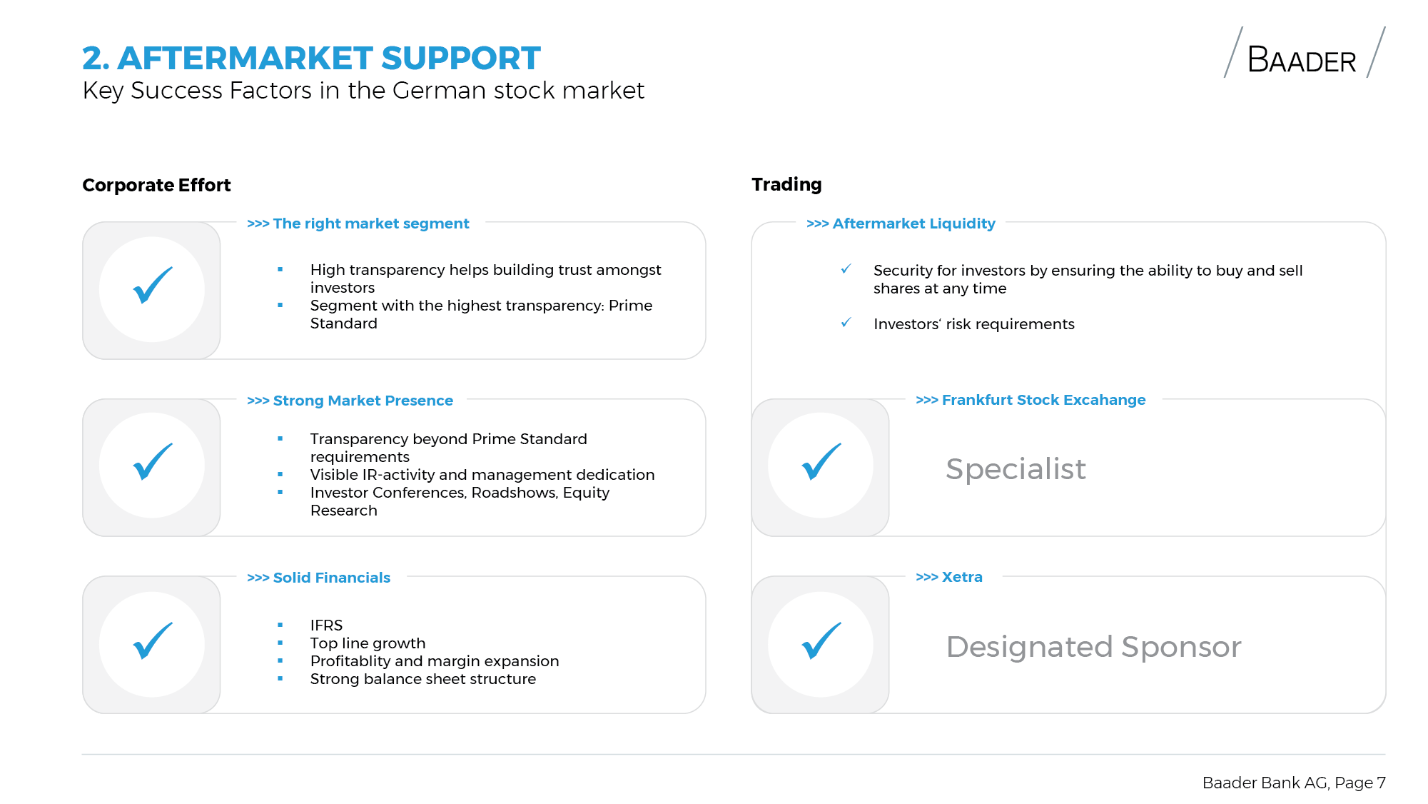

Slide 37


Slide 38
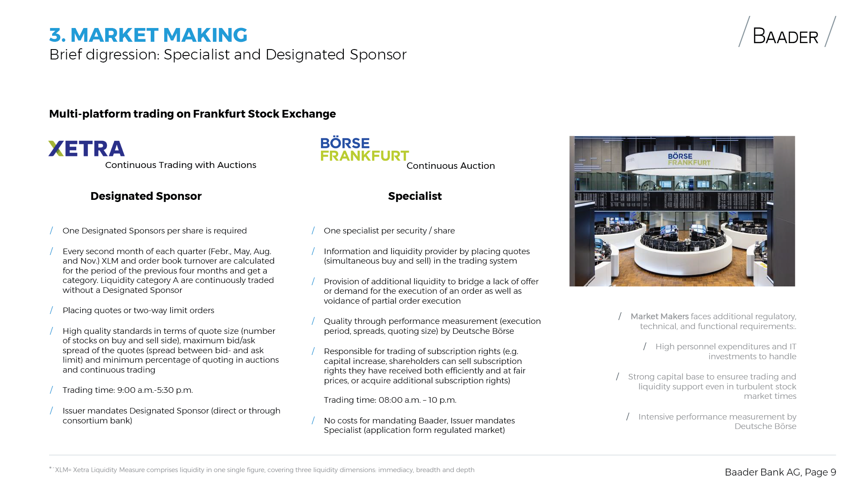

Slide 39
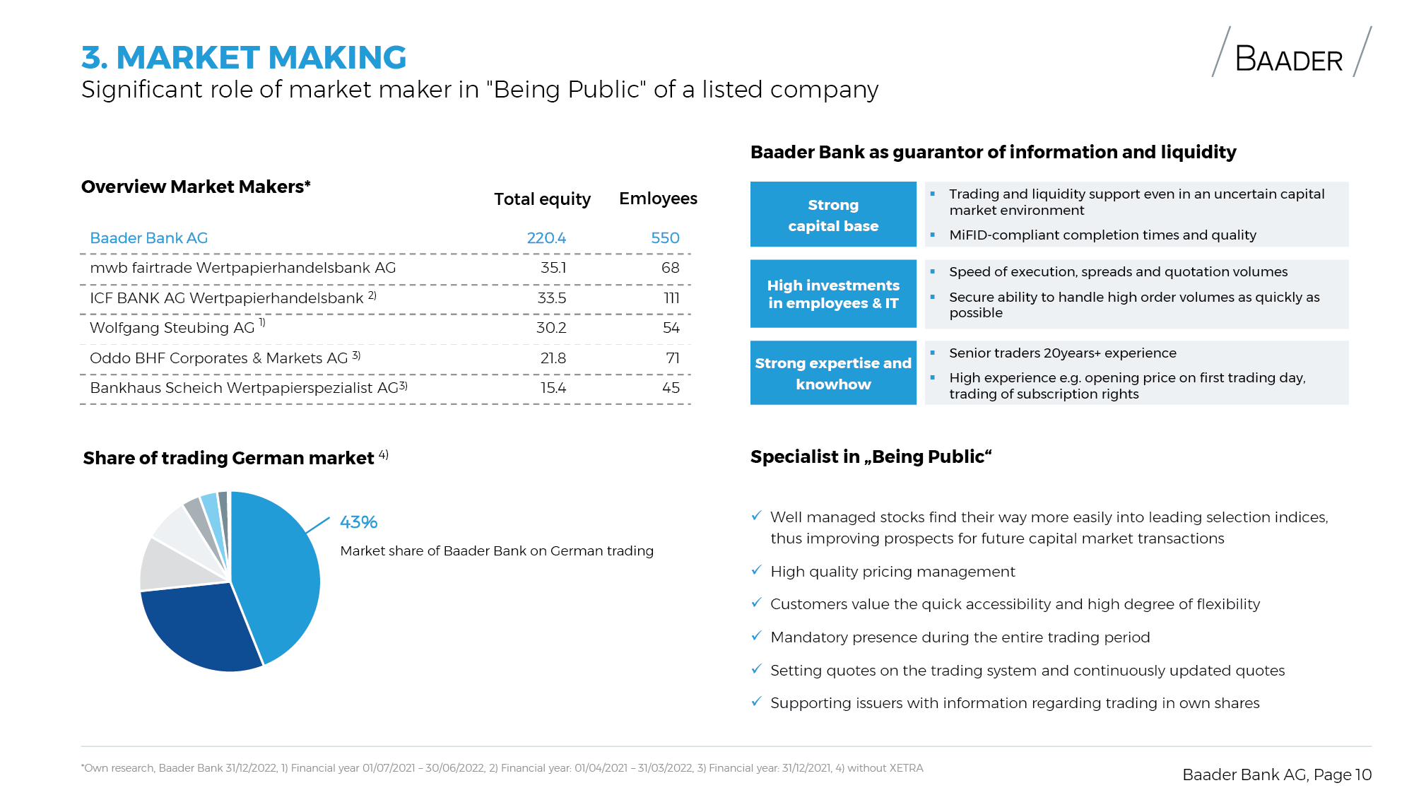

Slide 40
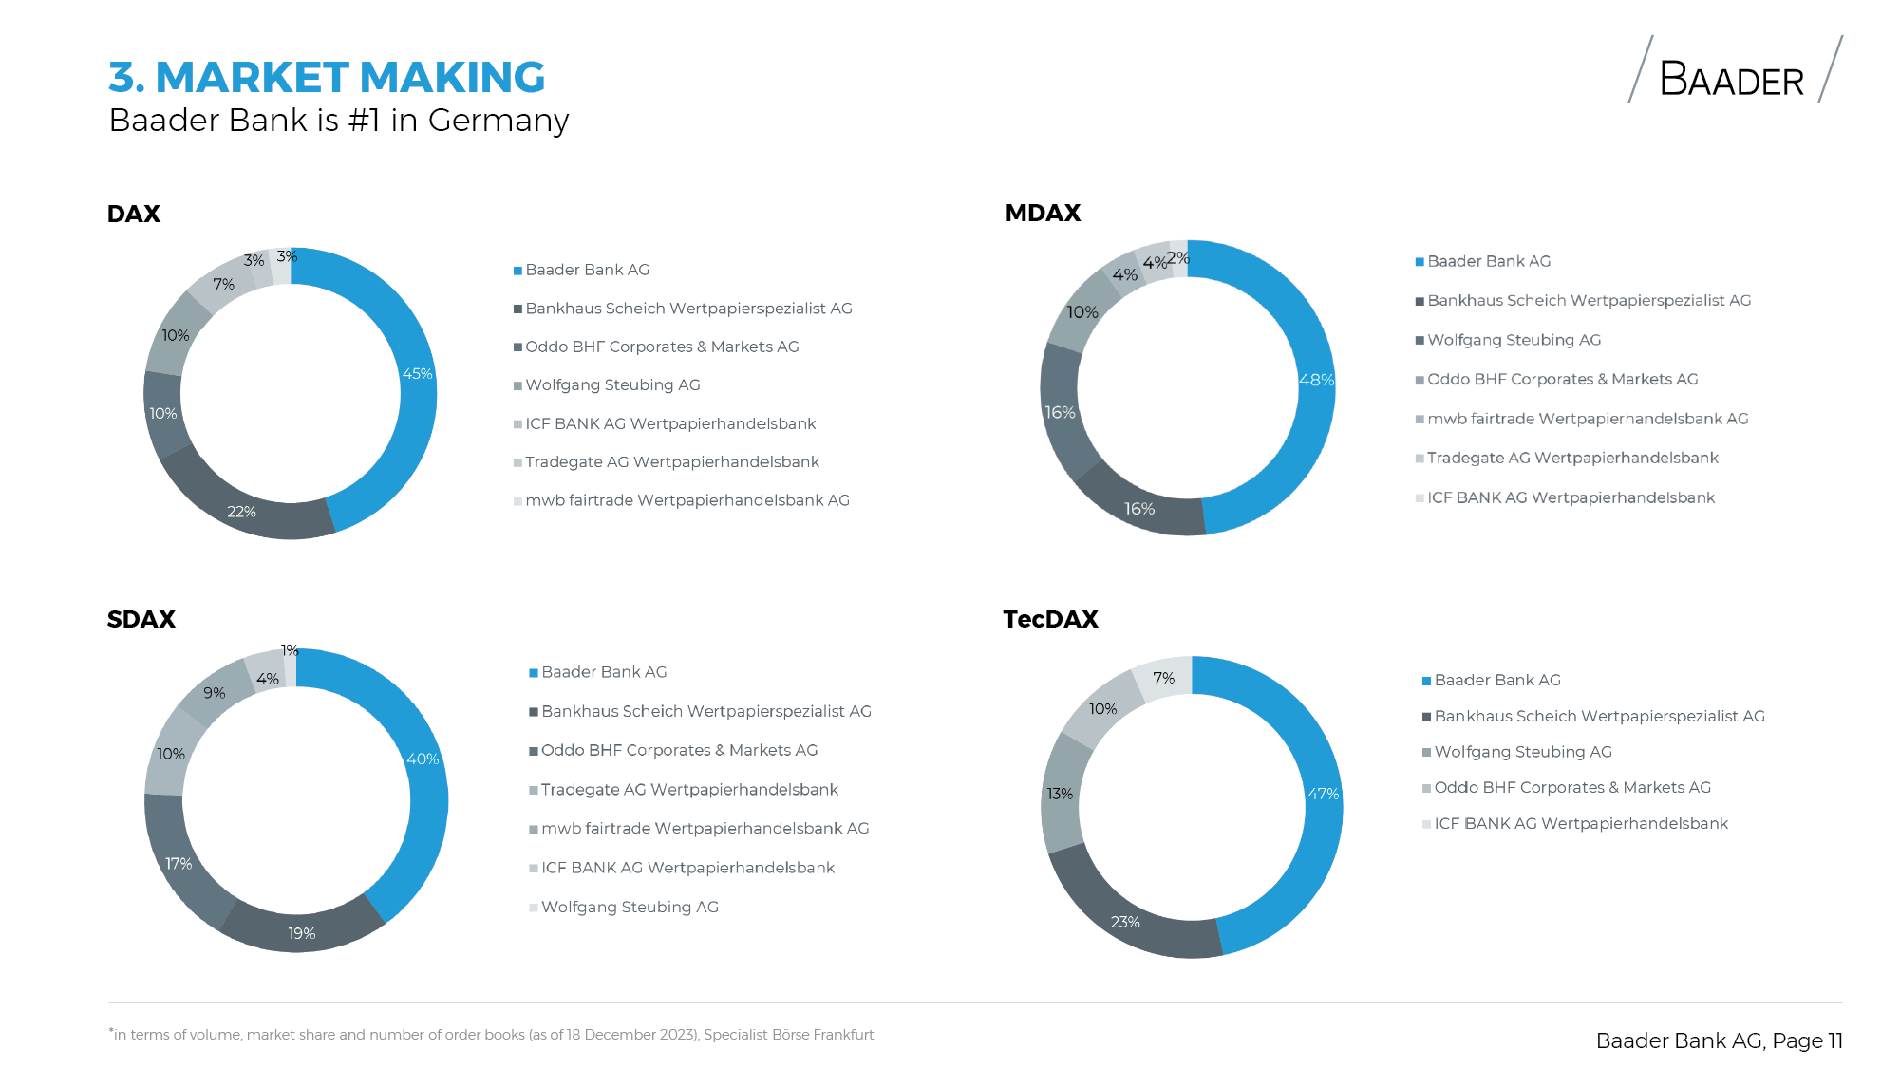

Slide 41
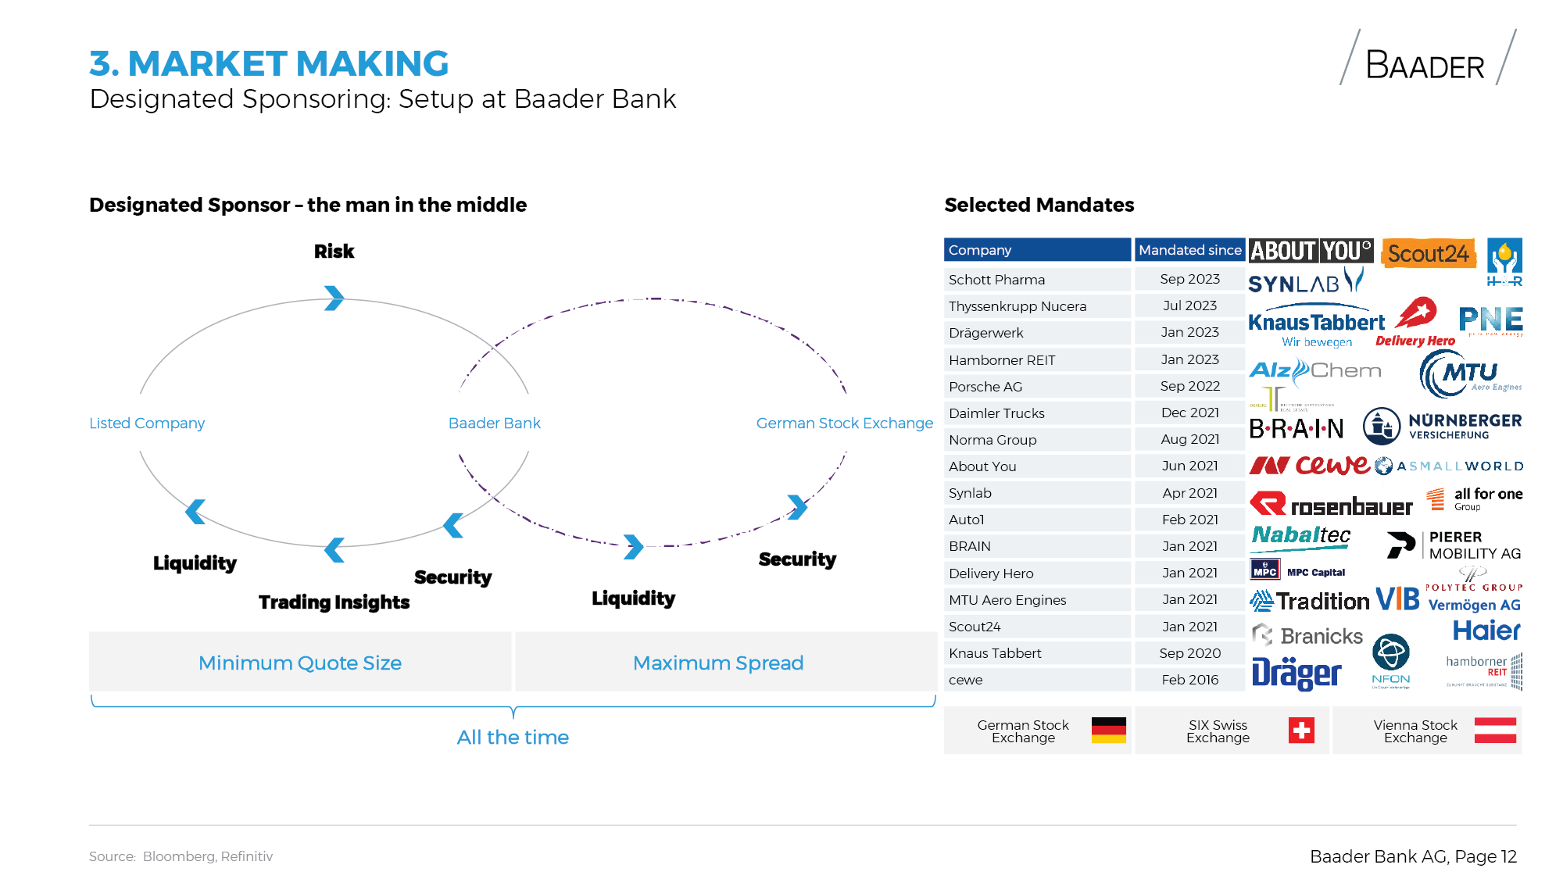

Slide 42
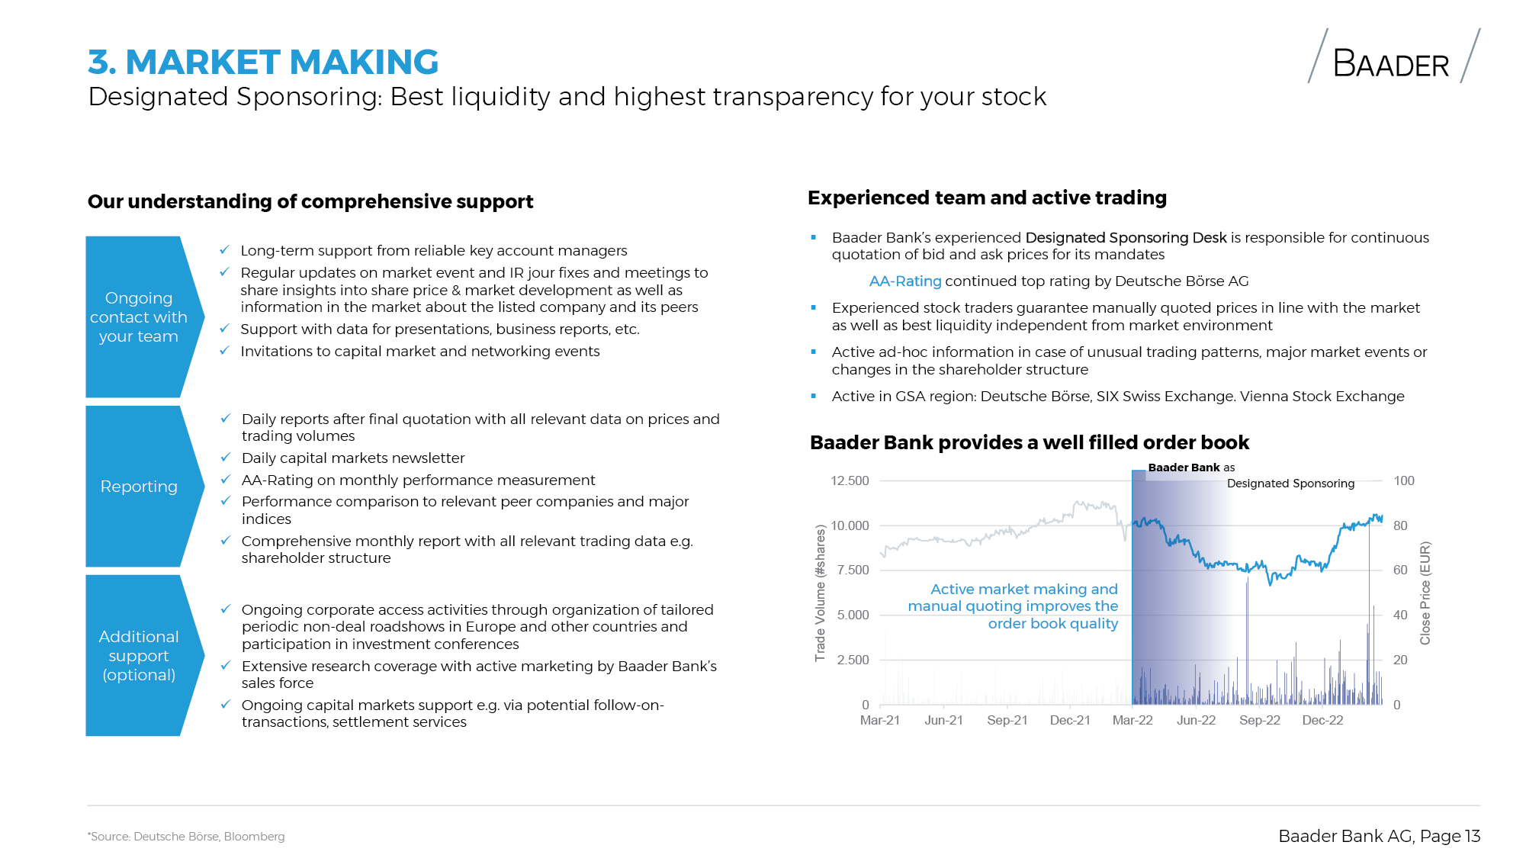

Slide 43


Slide 44
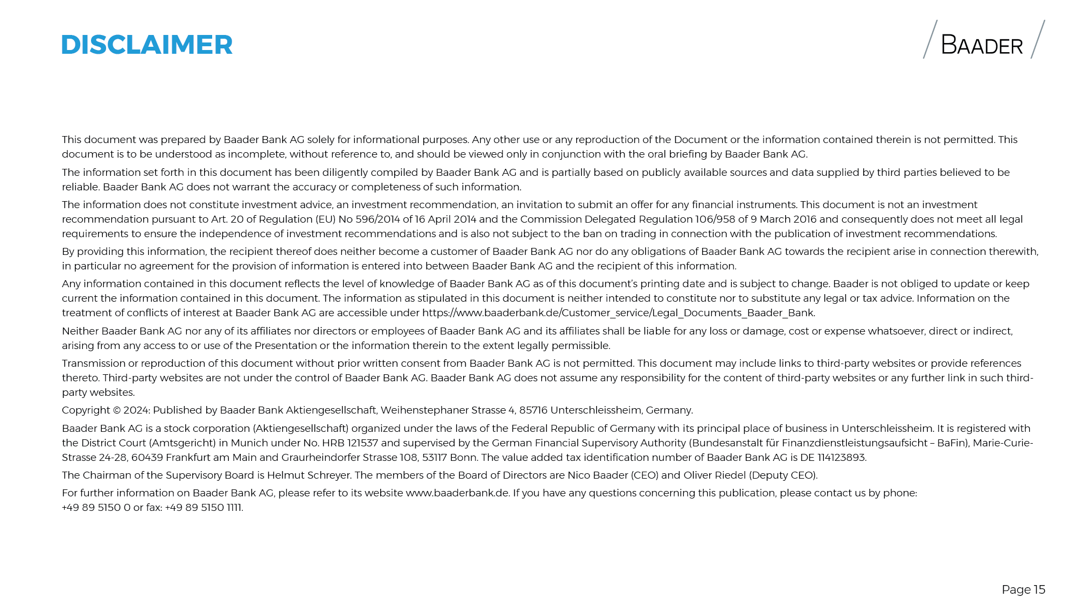

Slide 45
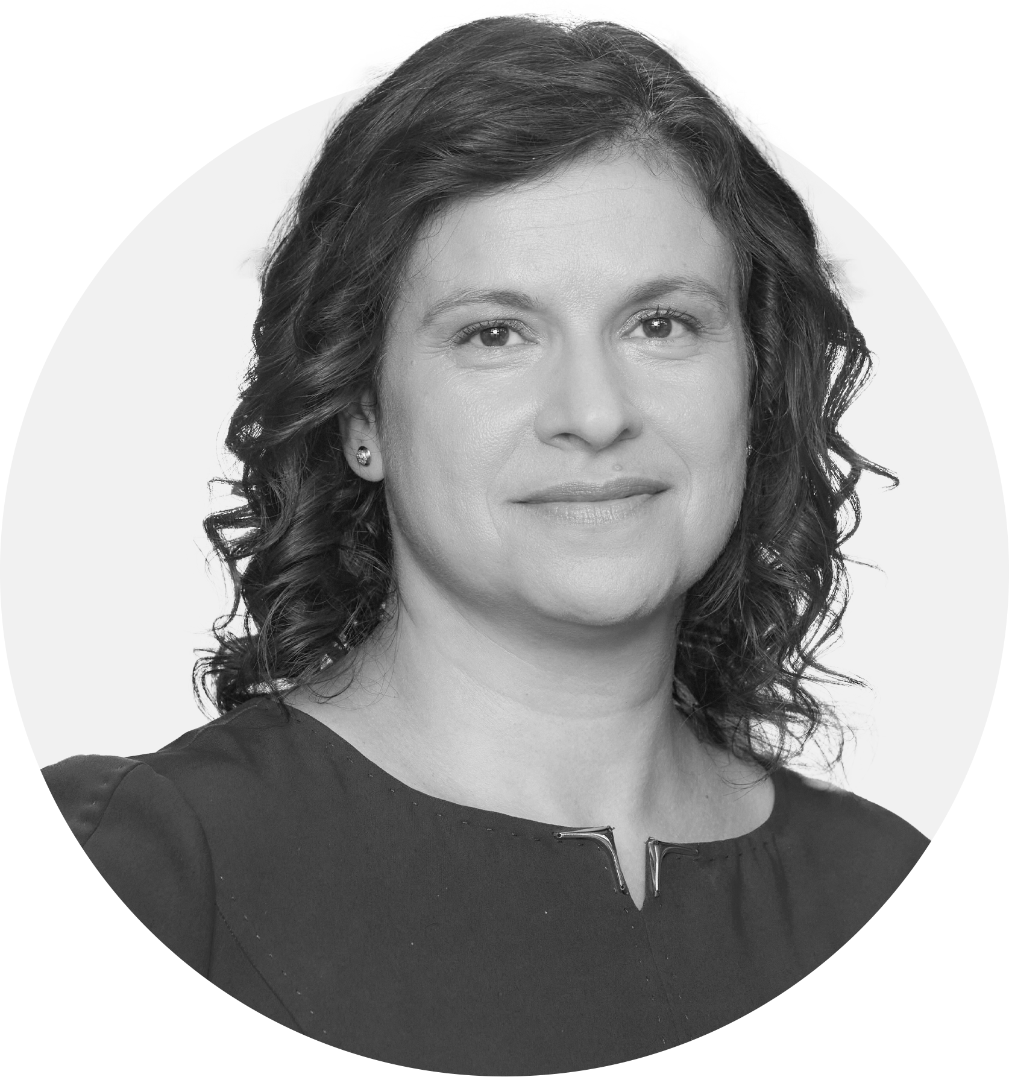

Krasimira Rayanova
Director / Head of Asset Servicing Product Development

Slide 46
We at Group Deutsche Börse create trust in the markets of today and tomorrow
Krasimira Rayanova
Director
Head of Asset Servicing,​ Clearstream Banking AG
BSE Investor Day
Sofia, 11 April 2024

Slide 47
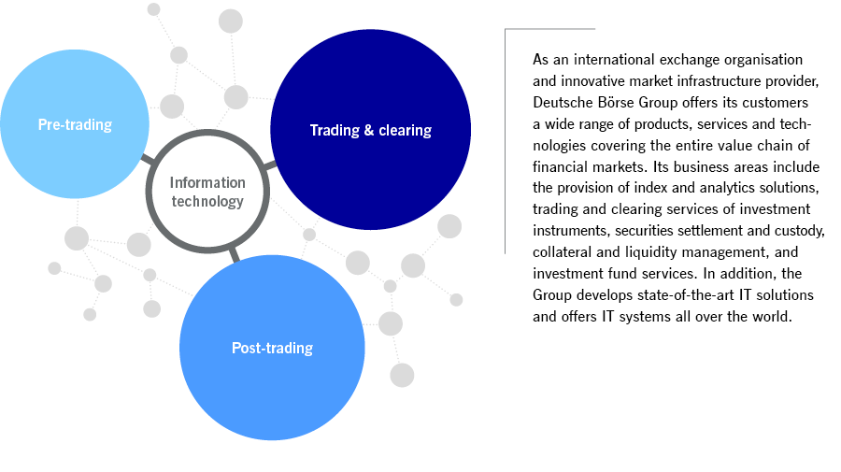
Group Deutsche Börse – Products and Services

Slide 48
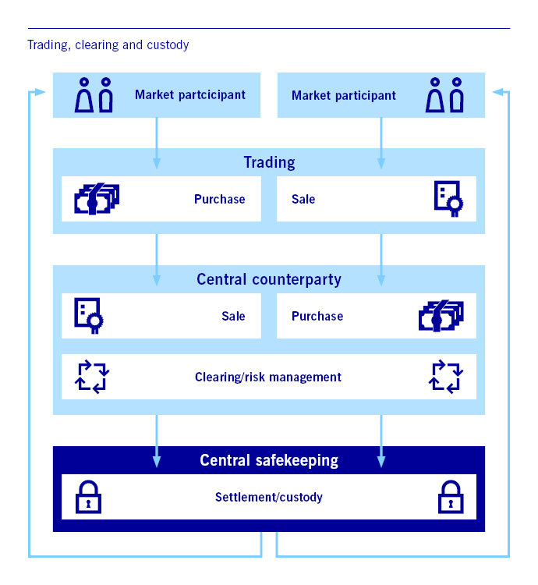
The infrastructure of the securites business
Clearing
Clearing is provided by Clearing houses – also called central counterparties (CCPs) – and minimizes the risk for trading participants individually and for the market as a whole.
A clearing house acts a counter-party to every trade and investment; ensuring funds are available, the transaction is documented and guarantees delivery of the securities to the buyer.
Settlement
Settlement is the process whereby securities and cash holdings are transferred (previously physically, nowadays electronically) between sellers and buyers. This normally takes place on a delivery-versus-payment basis.
Custody
Custody is the safekeeping of (settled) securities – either in intangible form (without any related certificates), as a book entry (with one or more global certificates), or in physical form (and immobilized).

Slide 49
Value chain
Cash and fixed income market as well as derivatives market instruments are subject to the value chain of Group Deutsche Börse
Information
Trading
Clearing
Settlement
Custody
  Streaming data feeds
  Physical terminals
  Indices
  Operate open electronic order books
  Connectivity to international trading members
  Verification of trade-related information
  Central counterparty (CCP)
  Risk Mgmt.
  Delivery of securities
  Financing services
  Securities lending & borrowing
  Physical custody of securities
  Related services, e.g. tax, corporate actions, income
Information
Services
FWB
Eurex
Clearing
Clearstream Banking
(Frankfurt and Luxemburg)
Eurex Exchange
IT-Services

Slide 50
Definition and functions of Eurex Clearing as central counterparty
Definition of the
Central Counterparty
Legal entity, which enters as contracting party into exchange/ off-exchange transactions concluded between two participants
Take-over of counterparty risk
Provide anonymity conditions after trade execution
Reduction in number of securities deliveries through offsetting
Simplified cross-border settlement
Cross-Margining services
(offsetting of pledged collateral across cash market and derivatives market transactions)
Functions of the
Central Counterparty

Slide 51
Clearstream Key Figures
12 locations worldwide | 2,500 clients in 110 countries |  | Processing over 1 million transactions daily
 |  |  | Managing € 600 billion in collateral on an overnight basis
60 markets | Funds from 50 countries | Can issue 30,000 securities per day
 |  |  | €17+ trillion AuC

Slide 52
What is post-trading about?
Once assets have been settled correctly, they are held in safe custody. Clearstream administers assets throughout the period for which they are held, offering services such as the handling of corporate actions and dividend payments – across all types of securities. Clearstream also provides investment fund services, including fund processing and fund distribution support. Moreover, the segregation of collateral margins allow market participants to efficiently comply with their regulatory obligations.
How are we achieving our goals?
Securities Sevices (custody, settlement, collateral and liquidity management)
Ensuring securities are correctly settled (i.e. credited to the accounts concerned) and
held in safe custody for banks and their clients
Operating Germany’s central securities depository (CSD) – the largest CSD in the Eurozone (CBF)
Operating Luxembourg’s CSD (LuxCSD) and one of the two international central securities depositories ICSDs (CBL)
Providing services for liquidity and collateral management
Making post-trading future-ready with innovative platform D7® to issue, hold and transfer digital financial instruments
Fund Services
Delivering investment fund services built on asset safety and distribution efficiency
Providing access to all fund types from mutual funds to ETFs and hedge funds via the Vestima® fund processing platform
Offering direct access to local domiciled funds in 50 fund jurisdictions worldwide
Providing fund distribution support services for fund distributors and asset managers worldwide via Clearstream Fund Centre
Our brands
Clearstream®, D7®, Eurex Repo®, LuxCSD®
Clearstream®, Vestima®

Slide 53


On the basis of five unique capabilities, Clearstream creates tangible client value
Backbone of European capital markets | Critical infrastructure provider as largest CSD and global gateway to Europe, supported by partnerships with Europe's largest exchange
Holistic securities services and collateral management offering | Comprehensive European settlement and custody services with leading collateral management proposition far beyond traditional CSD services
Global multi-network operator with leading data offering | Global multi-network with unique data set and tech capabilities to build a next generation capital markets ecosystem
Industry leading productivity | Industry leading productivity based on highly scalable and automated operations platform
Future-ready digital platform | Future-ready digital platform for growing in digital ecosystems, securities based on DLT and decentralised finance offerings
We provide safety and reliability to our clients as the backbone of European capital markets
We help clients achieve operational efficiency and risk reduction as a global multi-network operator by expanding Connectivity & Data services
We help our clients transition into the next generation of post-trade technology by driving digital processes with our future-ready platform

Slide 54


Market coverage
Our Custody Solution across Europe and beyond
CeBM model
ICSD model
2018 France, Belgium, Netherlands (ESES)
2018 Luxembourg (LuxCSD)
2018 Italy (Monte Titoli)
2018 Belgium (NBB)
2018 Austria (OeKB)
2019 Greece (BOGS)
2019 Baltics, Malta (Nasdaq CSD and MSE)
2020 Spain (Iberclear)
2020 Portugal (Interbolsa)
2020 Eurobonds (Phase I in 2019)
Argentina
Armenia
Australia
Austria
Belgium
BULGARIA
Canada
China
Croatia
Cyprus
Czech Republic
Denmark
Dubai
Estonia
Finland
France
Georgia
Germany
Greece
Hong Kong
Hungary
Iceland
Indonesia
Ireland
Israel
Italy
Japan
Latvia
Lithuania
Luxembourg
Malaysia
Malta
Mexico
Netherlands
New Zealand
Norway
Philippines
Poland
Portugal
Romania
Russia
Saudi Arabia
Serbia
Singapore
Slovakia
Slovenia
South Africa
South Korea
Spain
Sweden
Switzerland
Taiwan
Thailand
Turkey
Ukraine
UK
Uruguay
USA
60
Asset Protection
Capital Relief
Regulatory Compliance
Cost Reduction
Operational Resilience
Liquidity Optimization
Service Quality
Collateral Mobility
2022 - 2024 Denmark, Finland,
Slovenia and Slovakia

Slide 55
























European Post-Trade Landscape
Generic Clearstream model and value proposition for Europe
Customer Benefits
Single partner with low infrastructure risk profile - connecting to T2S in CeBM as well as CoBM
Leveraging securities consolidation effects and efficiencies across fixed income and equities
Delivering significant liquidity and funding efficiency benefits
Increased client flexibility thanks to agnostic product & service approach
Overall cost reduction thanks to process harmonization and operations efficiencies
Future-proofing securities settlement and custody process with regulatory compliance
Single partner with low infrastructure risk profile - connecting to T2S in CeBM as well as CoBM
Leveraging securities consolidation effects and efficiencies across fixed income and equities
Delivering significant liquidity and funding efficiency benefits
Increased client flexibility thanks to agnostic product & service approach
Overall cost reduction thanks to process harmonization and operations efficiencies
Future-proofing securities settlement and custody process with regulatory compliance
Traditional custody models
Clearstream’s Custody Model
Market
Agent A
Agent B
Agent C
Agent D
Agent E
Consolidated Safekeep accounts across all markets &
single collateral pool
Agent
Safekeep accounts
Safekeep accounts
Safekeep accounts
Safekeep accounts
Safekeep accounts
Consolidated Dedicated Cash Account (DCA) at NCB
Cash accounts
Cash accounts
Cash accounts
Cash accounts
Cash accounts
Markets & Infrastructure
Asset Servicing Market Partners
CSD
NCB
NCB

Slide 56








Securities servicing model at the core of our proposition
Agnostic to access point or money-quality, delivered through a single connectivity
Xact
Connectivity
Chanel
Single connectivity platform – CBL or CBF access sufficient to enjoy entire suite of markets and services. No change required for clients
European Markets/
T2S
Eurobonds
Global
Market
Access
All 60 markets, asset classes and currencies accessible through a single account
CSD
ICSD
Access Model
Single liquidity pool of ICSD and CSD assets. Collateral can be seamlessly transferred at any time between CSD accounts and ICSD
CeBM (EUR)
CoBM
Cash
Quality
Choice to keep settlement in CoBM or CeBM
CASCADE/T2S
CreationOnline
Settlement System
Settlement rates at Clearstream are higher compared to market average. Overall settlement efficiency across CBF and CBL is averaging 92% across all European markets
OneClearstream Asset Servicing
Asset Servicing delivered by dedicated domestic market partner institutions across both platforms – where still required. Asset Servicing quality harmonized across infrastructures. Settlement deadlines across major European markets are 5 minutes to market deadlines. Asset servicing deadlines between 1-3 hours of domestic market deadlines
Local market proximity concept for managing complex questions and hosting trilateral calls in exceptional circumstances available
Asset Servicing

Slide 57



Future flow for dual-listed securities
Key Facts
Existing flows for Clearstream stays as is today. Asset servicing will be received in BGN for the ISINs that are still traded in Bulgarian SE
New flows added via XETRA are settled in EUR. Asset servicing information for those ISINs will be sent in EUR from the depository
Clear differentiation between BGN and EUR flows:
    If an ISIN is traded in both stock exchanges, then the ISINs will be traded in EUR
    Same ISIN will not be traded in different currencies
Trading of BG ISINs in EUR
Trading of BG ISINs in EUR and BGN
Settlement of Bulgarian ISINs
Example:
BG1 - EUR
BG2 - EUR
Example:
BG3 - BGN,
BG4 - BGN
Example:
BG1 - EUR
BG2 - EUR
CA Data for BG ISINs (BG3, BG4) in BGN
CA Data for BG ISINs (BG1, BG2) in EUR
Clearing of BG ISINs EUR
Settlement of BG ISINs in EUR and BGN

Slide 58

QUIZ

Slide 59
What is the purpose of Deutsche Börse Group:
      We make cash markets work
      Clearing a way for our customers
      We create trust in the markets of today and tomorrow

Slide 60
Deutsche Börse Group (DBG) offers the possibility for trading of the following instruments:
      Equities and ETFs only
      Diverse range of asset classes, e.g. equities, derivatives, certificates and warrants, fixed income products
      Equities and derivative products

Slide 61
What are the benefits for a client using a Clearing house (CCP), e.g. Eurex Clearing compared to OTC bilateral trading?
      The main benefits of a CCP are reduced counterparty risk, increased transparency and improved efficiency
      Central clearing encourages interconnectedness while allowing buyer and seller to interact bilaterally. CCPs expose their clients to bilateral default risk
      None. Because Clearing Houses (CCPs) charge a fee for their service offering without tangible benefits for the market

Slide 62
Within the value chain Clearstream Banking acts as a:
      Stock Exchange
      Clearing House (CCP)
      (International) Central Securities Depository/ (I)CSD

Slide 63

Maria Filipova
Deputy Chair of the Financial Supervision Commission

Slide 64


ДОСТЪП НА КОМПАНИИТЕ ДО
БЪЛГАРСКИЯ КАПИТАЛОВ ПАЗАР

Slide 65
I. КОМУНИКАЦИЯ МЕЖДУ
РЕГУЛАТОРИТЕ И РЕГУЛАТОРНИ
ПРОЦЕДУРИ

Slide 66


I. КОМУНИКАЦИЯ МЕЖДУ РЕГУЛАТОРИТЕ И РЕГУЛАТОРНИ ПРОЦЕДУРИ
Обхват на одобренията на проспектите в рамките на Съюза
При извършване на публично предлагане на ценни книжа или допускане до търговия на регулиран пазар в една или повече държави членки, или в държава членка, различна от държавата членка по произход, одобреният от държавата членка по произход проспект, както и всякакви допълнения към него, са валидни за публичното предлагане или допускането до търговия във всички приемащи държави членки, при условие че Европейският орган за ценни книжа и пазари и компетентният орган на всяка приемаща държава членка са уведомени в съответствие с член 25 от Регламент (ЕС) 2017/1129.
Компетентните органи на приемащите държави членки не предприемат процедури по одобрение или административни процедури във връзка с проспектите и допълненията, одобрени от компетентните органи на други държави членки, и които са свързани с окончателните условия.

Slide 67

I. КОМУНИКАЦИЯ МЕЖДУ РЕГУЛАТОРИТЕ И РЕГУЛАТОРНИ ПРОЦЕДУРИ
Уведомяване относно проспектите и допълненията при трансгранично предлагане и допускане до търговия на регулиран пазар
Компетентният орган на държавата членка по произход в рамките на 1 работен ден след получаването на такова искане или, когато искането е представено едновременно с проекта за проспект, в рамките на 1 работен ден след одобрението на проспекта, уведомява компетентния орган на приемащата държава членка чрез удостоверение за одобрение.
Уведомяване относно проспектите и допълненията
Потвърждение, че проспектът е бил изготвен в съответствие с Регламент (ЕС) 2017/1129, както и чрез предоставяне на електронно копие на този проспект.
Удостоверението се изготвя по унифициран образец, разработен от ЕОЦКП.
Съпровожда с превод на проспекта и резюмето, предоставени от емитента, предложителя, лицето, което иска допускане на ценни книжа до търговия на регулиран пазар, или лицето, което отговаря за изготвянето на проспекта.

Slide 68
I. КОМУНИКАЦИЯ МЕЖДУ РЕГУЛАТОРИТЕ И РЕГУЛАТОРНИ ПРОЦЕДУРИ
Уведомления
Уведомяване на заявителя
Емитентът, предложителят, лицето, което иска допускане на ценни книжа до търговия на регулиран пазар, или лицето, което отговаря за изготвянето на проспекта
Уведомяване
на ЕОЦКП
Уведомява ЕОЦКП относно удостоверението за одобрение на проспекта или допълнението към него едновременно с уведомяването на компетентния орган на приемащата държава членка
Уведомления
Разходи във
връзка с
уведомяването
Компетентните органи не налагат такса за уведомяването или получаването на уведомление за проспекти и допълнения към тях или за свързана дейност по надзор, независимо дали се осъществява в държавата членка по произход или в приемащата държава/приемащите държави.

Slide 69
II. ПЪТЯТ НА ЕДНА КОМПАНИЯ
КЪМ ПУБЛИЧНО ПРЕДЛАГАНЕ И
ДОПУСКАНЕ ДО РЕГУЛИРАН ПАЗАР

Slide 70
II. ПЪТЯТ НА ЕДНА КОМПАНИЯ КЪМ ПУБЛИЧНО ПРЕДЛАГАНЕ И ДОПУСКАНЕ ДО РЕГУЛИРАН ПАЗАР
Изискване за проспект. Приложими нормативни актове (НА).
Публично предлагане на ценни книжа и/или допускане на ценни книжа до търговия на регулиран пазар се извършва след публикуване на одобрен от КФН проспект.
Регламент (EС) 2017/1129 на Европейския парламент и на Съвета от 14 юни 2017 г. относно проспекта, който трябва да се публикува при публично предлагане или допускане на ценни книжа до търговия на регулиран пазар, и за отмяна на Директива 2003/71/ЕО (Регламент (EС) 2017/1129), Глава шеста от Закона за публичното предлагане на ценни книжа и актовете по прилагането им.
ПРОСПЕКТ
Делегирани актове по прилагане на Регламент (EС) 2017/1129.

Slide 71


II. ПЪТЯТ НА ЕДНА КОМПАНИЯ КЪМ ПУБЛИЧНО ПРЕДЛАГАНЕ И ДОПУСКАНЕ ДО РЕГУЛИРАН ПАЗАР
Изискване за подаване на заявление за одобрение на проспект и прилагани документи.
образец на заявление за одобрение на проспект съгласно ЗППЦК;
проспектът в електронен формат с възможност за търсене в документа;
ЗАЯВЛЕНИЕ И ПРИЛОЖЕНИЕ
документи за заявителя;
решението за публичното предлагане на ценни книжа и/или за допускането на ценните книжа до търговия на регулиран пазар;
други документи, изрично посочени в приложимото законодателство.

Slide 72
II. ПЪТЯТ НА ЕДНА КОМПАНИЯ КЪМ ПУБЛИЧНО ПРЕДЛАГАНЕ И ДОПУСКАНЕ ДО РЕГУЛИРАН ПАЗАР
Срокове за разглеждане на проспектите.
Мотивирано решение на КФН.
10 работни дни за редовни емитенти и 20 работни дни, когато публичното предлагане включва ценни книжа, които са издадени от емитент, който не притежава каквито и да било ценни книжа, допуснати до търговия на регулиран пазар, и който преди това не е предлагал публично ценни книжа.
СРОКОВЕ
При необходимост от последващо представяне на коригиран проспект и/или допълнителна информация, КФН следва да се произнесе в рамките на по-краткия срок от 10 работни дни.
С писмено мотивирано решение КФН може да одобри или да откаже одобрение на проспект.

Slide 73

II. ПЪТЯТ НА ЕДНА КОМПАНИЯ КЪМ ПУБЛИЧНО ПРЕДЛАГАНЕ И ДОПУСКАНЕ ДО РЕГУЛИРАН ПАЗАР
Структура и обхват на проспекта.
СТРУКТУРА НА ПРОСПЕКТА
Приложения към Делегиран
регламент (ЕС) 2017/980
ЕДИНЕН
ДОКУМЕНТ
ОТДЕЛНИ
ДОКУМЕНТИ
Регистрационен документ
Документ за ценните книжа
Резюме

Slide 74
II. ПЪТЯТ НА ЕДНА КОМПАНИЯ КЪМ ПУБЛИЧНО ПРЕДЛАГАНЕ И ДОПУСКАНЕ ДО РЕГУЛИРАН ПАЗАР
Опростяване на съдържанието на проспекта.
За определени лица е налице възможност да изберат да изготвят опростен проспект съгласно опростен режим на оповестяване за вторични емисии при публично предлагане на ценни книжа или допускане на ценни книжа до търговия на регулиран пазар.
Изключва се част от стандартно изискваната информация за емитента, а в определени хипотези и за ценните книжа
Емитентите, чиито ценни книжа са били постоянно допуснати до търговия на регулиран пазар или на пазар за растеж на малки и средни предприятия през най-малко последните 18 месеца

Slide 75
II. ПЪТЯТ НА ЕДНА КОМПАНИЯ КЪМ ПУБЛИЧНО ПРЕДЛАГАНЕ И ДОПУСКАНЕ ДО РЕГУЛИРАН ПАЗАР
Допълнения към проспекта.
При настъпване, съответно узнаване на съществено ново обстоятелство, грешка или неточност, свързани със съдържащата се в проспекта информация, които може да повлияят на оценката на ценните книжа в периода от издаване на одобрение на проспекта до изтичането на крайния срок на публичното предлагане или започването на търговията на регулиран пазар, се изготвя допълнение към проспекта.
Допълнението към проспект се одобрява от КФН по същия начин като проспект в рамките на не повече от 5 работни дни.
Допълнението се публикува в съответствие със същите изисквания, които са приложими при публикуването на одобрения проспект.

Slide 76
III. ПОСЛЕДВАЩИ ИЗИСКВАНИЯ
ЗА РАЗКРИВАНЕ НА ИНФОРМАЦИЯ

Slide 77

III. ПОСЛЕДВАЩИ ИЗИСКВАНИЯ ЗА РАЗКРИВАНЕ НА ИНФОРМАЦИЯ
Допълнителни изисквания към дейността на дружествата
и разкриваната от тях информация
С цел защита правата на инвеститорите/акционерите в публичните дружества, и в частност на непрофесионалните такива, законодателят е предвидил по-строги от общите изисквания към дейността им, както и различни по естеството си контролни и надзорни механизми.
ЗАЩИТА ПРАВАТА НА
ИНВЕСТИТОРИТЕ И АКЦИОНЕРИТЕ
Свикване и провеждане на ОСА;
Публичните дружества са длъжни да разкриват публично информация, относно своето финансово-икономическо и правно състояние, допълнена по обем спрямо дължимата от обикновените АД.
Сключване на сделки от управителните органи;
Разкриване на регулирана информация;
Разкриване на вътрешна информация.

Slide 78
III. ПОСЛЕДВАЩИ ИЗИСКВАНИЯ ЗА РАЗКРИВАНЕ НА ИНФОРМАЦИЯ – ДИГИТАЛИЗАЦИЯ НА ПАЗАРА
Възможност за използване на електронни средства
Законодателят е допуснал възможност, ПД да предвиди в своя устав и/или в поканата за свикване на общото събрание, то да се провежда чрез използване на електронни средства, посредством една или повече от следните форми:
предаване в реално време на общото събрание;
ФОРМИ
НА
ПРОВЕЖДАНЕ
двупосочни съобщения в реално време, позволяващи на акционерите да участват в обсъждането и вземането на решения в общото събрание от разстояние;
механизъм за гласуване преди или по време на общото събрание, без да е необходимо упълномощаване на лице, което да участва лично на общото събрание.

Slide 79
III. ПОСЛЕДВАЩИ ИЗИСКВАНИЯ ЗА РАЗКРИВАНЕ НА ИНФОРМАЦИЯ –
Изплащане на шестмесечен дивидент
В ЗППЦК е предвидена възможност за ПД, каквато по ТЗ не съществува. След 01.01.2018 г., ПД имат право да изплащат 6-месечен, наред с годишния дивидент, ако това е предвидено в устава и при съответно прилагане на чл. 247а от ТЗ.
Правото да получат дивидент ще имат лицата, вписани в регистрите на Централния депозитар като такива с право на дивидент на 14-ия ден след деня на общото събрание, на което е приет годишният, съответно 6-месечният финансов отчет, и е взето решение за разпределение на печалбата.
ДИВИДЕНТ
Дружеството е длъжно незабавно да уведоми комисията, Централния депозитар и регулирания пазар за решението на общото събрание относно вида и размера на дивидента, както и относно условията и реда за неговото изплащане, включително да посочи поне една финансова институция, чрез която ще се извършват плащанията.

Slide 80
III. ПОСЛЕДВАЩИ ИЗИСКВАНИЯ ЗА РАЗКРИВАНЕ НА ИНФОРМАЦИЯ
Ограничителен режим за сделки на ПД и дъщерните му дружества
Ограничителен режим за сделки на ПД и дъщерните му дружества, насочен към защита на инвеститорите срещу лишаване на ПД от неговите активи или срещу поемане на значителни задължения и др., с оглед предотвратяване на възможността за несанкционирано сключване на сделки при наличие на конфликт на интереси.
Предварително одобрение от съответния дружествен орган, ОСА за сделките на ПД или управителния орган на ПД – за сделките, осъществявани от представляващите непубличните дружества, които са дъщерни на публичното.
Мотивиран доклад за целесъобразността и условията на сделките по чл. 114, ал. 1 от ЗППЦК, в нормативно определения срок и с регламентирано минимално съдържание.

Slide 81
III. ПОСЛЕДВАЩИ ИЗИСКВАНИЯ ЗА РАЗКРИВАНЕ НА ИНФОРМАЦИЯ
Директор за връзки с инвеститорите
Необходимост от двупосочна връзка между управителния орган на ПД и инвеститорите му и между дружеството и регулаторния орган. В тази връзка, управителният орган на публичното дружество е длъжен да назначи по трудов договор директор за връзки с инвеститорите.
Дружества, които не са били публични, следва да изпълняват задължението в 3-месечен срок от придобиването на публичен статут.
Инвеститори
Публично дружество
Регулаторен орган
ДВИ
ДВИ

Slide 82

III. ПОСЛЕДВАЩИ ИЗИСКВАНИЯ ЗА РАЗКРИВАНЕ НА ИНФОРМАЦИЯ
Разкриване на регулирана информация
С оглед защита правата на инвеститорите и с цел осигуряване на прозрачност на пазара всеки емитент, попадащ в обхвата на ЗППЦК, в това число и ПД, е длъжно да разкрива регулирана информация по предвидения в ЗППЦК ред, която обхваща:
периодична финансовоотчетна и друга информация по Глава VI „а“ на ЗППЦК;
Достигането й до възможно най-широк кръг лица едновременно, и по начин, който не ги дискриминира.
другата регулирана информация по смисъла на ЗППЦК – относно промяната в дяловото участие на акционерите му;
РЕГУЛИРАНА
ИНФОРМАЦИЯ
Използване на информационна агенция или друга медия.
вътрешна информация (съгласно Регламент (ЕС) № 596/2014);
Регулираната информация се разкрива на комисията по електронен път, а изискванията към формата и съдържанието на регулираната информация, както и условията, начините и редът за нейното разкриване се определят с Наредба № 2.
последващо разкриване на специфична информация, уведомяване на КФН за настъпването на обстоятелствата, подлежащи на вписване във водените от нея регистри по чл.30 от ЗКФН, включително и за настъпили промени в тях.

Slide 83
III. ПОСЛЕДВАЩИ ИЗИСКВАНИЯ ЗА РАЗКРИВАНЕ НА ИНФОРМАЦИЯ
Разкриване на вътрешна информация и забавено разкриване на вътрешна информация
Емитентите, чиито финансови инструменти са допуснати или по отношение на които е поискано допускане до регулиран пазар или многостранна система за търговия при първа възможност публично разкриват вътрешната информация, която ги засяга пряко.
Точна информация, която не е била направена публично достояние, свързана пряко или косвено с един или повече емитенти, или с един или повече финансови инструменти и която, ако бъде направена публично достояние, би могла да повлияе чувствително върху цената на тези финансови инструменти или на свързаните с тях дериватни финансови инструменти;
ВЪТРЕШНА ИНФОРМАЦИЯ
Способства бързия достъп и пълната, точна и своевременна оценка на информацията от обществеността;
Емитентът публикува и поддържа на своя уебсайт за срок от най-малко пет години цялата вътрешна информация, която е задължен да разкрие публично.

Slide 84
III. ПОСЛЕДВАЩИ ИЗИСКВАНИЯ ЗА РАЗКРИВАНЕ НА ИНФОРМАЦИЯ
Забавено разкриване на вътрешна информация
Емитентите могат на своя отговорност да забавят разкриването на вътрешната информация, ако са спазени кумулативно определените в Регламент (ЕС) 2014/596 условия:
незабавното разкриване е вероятно да увреди законните интереси на емитента или на участника на пазара на квоти за емисии;
няма вероятност забавянето на разкриването да подведе обществеността;
емитентът или участникът на пазара на квоти за емисии може да гарантира поверителността на тази информация.

Slide 85
III. ПОСЛЕДВАЩИ ИЗИСКВАНИЯ ЗА РАЗКРИВАНЕ НА ИНФОРМАЦИЯ
Език на разкриване на регулираната информация
Когато ценните книжа са допуснати до търговия на регулиран пазар единствено в Република България и Република България е държавата членка по произход, регулираната информация се разкрива на български език.
Български
език
Когато ценните книжа са допуснати до търговия на регулиран пазар едновременно в една или повече държави членки, включително в Република България, и Република България е държавата членка по произход, регулираната информация се разкрива на български език и на език, приет от компетентния орган на тези държави, или на език, обичаен в сферата на международните финанси, по избор на емитента.
Български език
и приетият в съответната държава
Когато ценните книжа са допуснати до търговия на регулиран пазар едновременно в една или повече държави членки, с изключение на Република България, и Република България е държавата членка по произход, регулираната информация се разкрива на език, приет от компетентните органи на тези държави членки, или на език, който е обичаен в сферата на международните финанси, по избор на емитента. За целите на осъществяване на надзорните функции на комисията информацията се разкрива и на български език или на английски език, по избор на емитента.
Български
и английски
език

Slide 86
III. ПОСЛЕДВАЩИ ИЗИСКВАНИЯ ЗА РАЗКРИВАНЕ НА ИНФОРМАЦИЯ
Език на изготвяне на проспекта
Проспектът се изготвя на езика, който е приет от компетентния орган на държавата членка по произход, и също така се предоставя на езика, който се приема от компетентните органи на всяка приемаща държава членка или на език, който е обичаен в областта на международните финанси, по избор .
Език на проспекта
Компетентният орган на всяка приемаща държава членка изисква резюмето на проспекта да бъде достъпно на официалния език на държавата членка или поне на един от официалните ѝ езици, или на друг език, който се приема от компетентния орган на тази държава членка, но не изисква превод на друга част на проспекта.
Език на
резюмето

Slide 87







БЛАГОДАРЯ ЗА ВНИМАНИЕТО!
www.fsc.bg
www.eis.fsc.bg
FSC Mobile
#Инвестирай безопасно
#Financial supervision commission
Комисия за финансов надзор

Slide 88
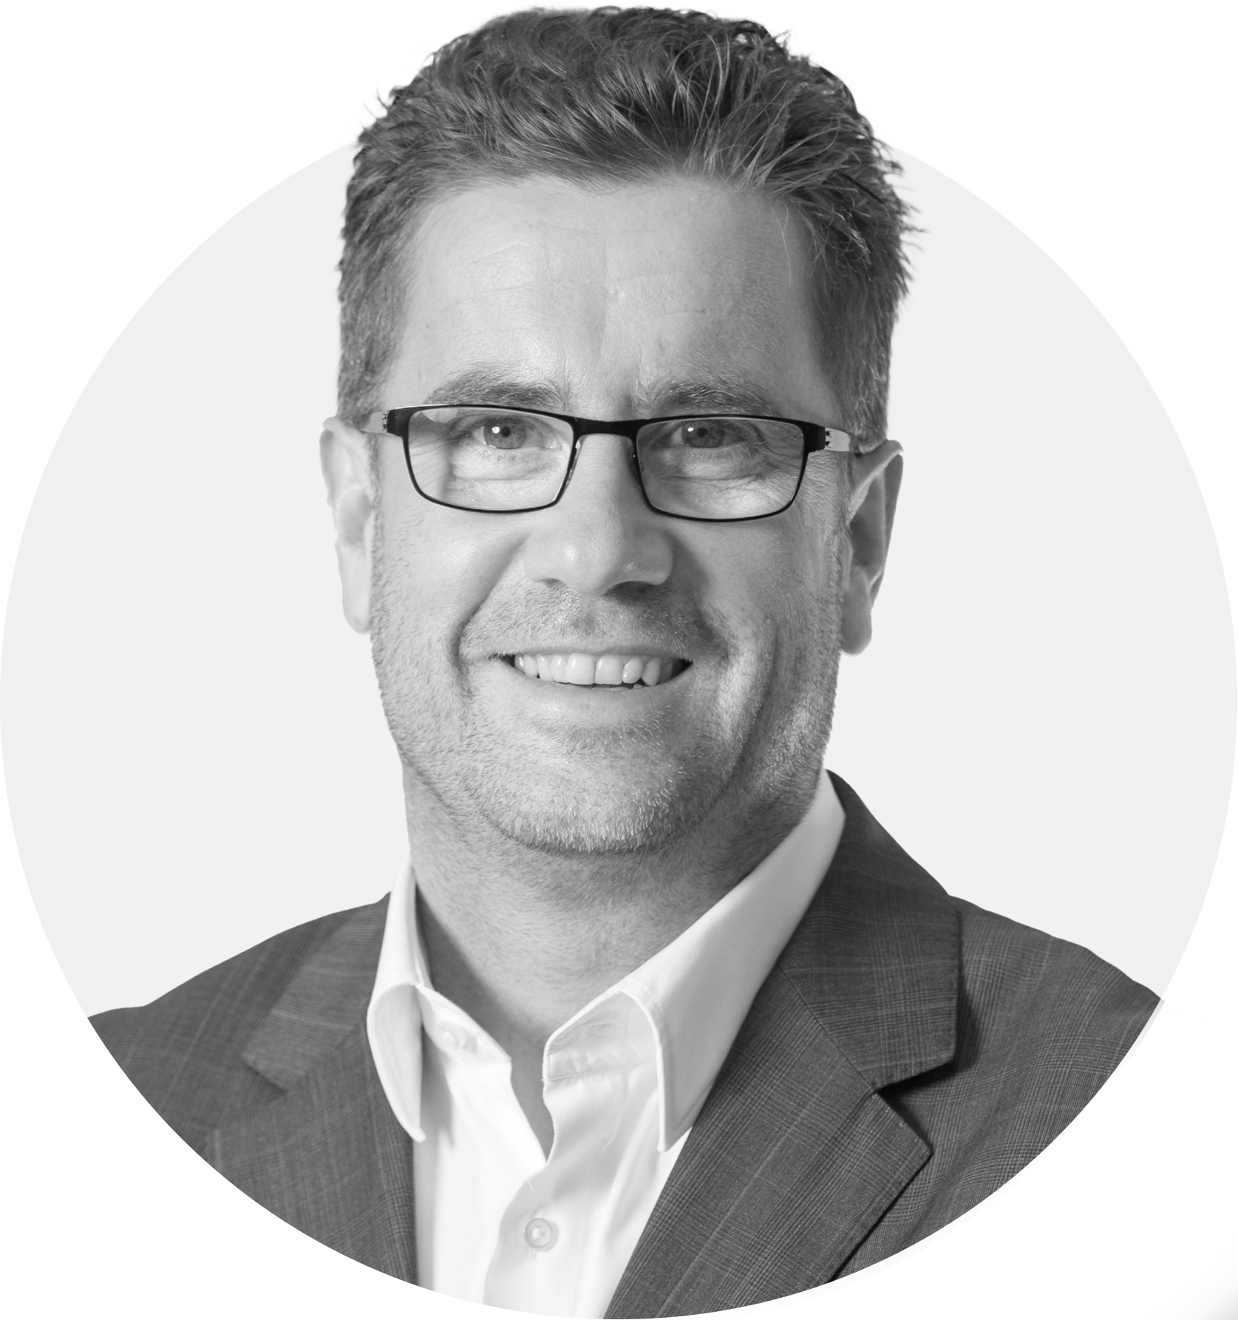

Wolfgang Kirsch
CEO of Shelly Group AD

Slide 89


Slide 90

Entering Frankfurt
Stock Exchange
Shelly Group’s story

Slide 91












Pros
Cons
Access to a huge number of investors of every size
Limited visibility due to huge number of investment opportunities
More institutional investors leading to share price stabilization
No room for mistakes
Uplift potential
High market requirements
Wider Investors structure gives higher security
Fight for the spotlight
Higher trading volume
Time consuming

Slide 92





What it takes
Visibility
Precise reporting
Team of advisors
Build trust -
promise & deliver
Time – Rule of 7
Resources

Slide 93
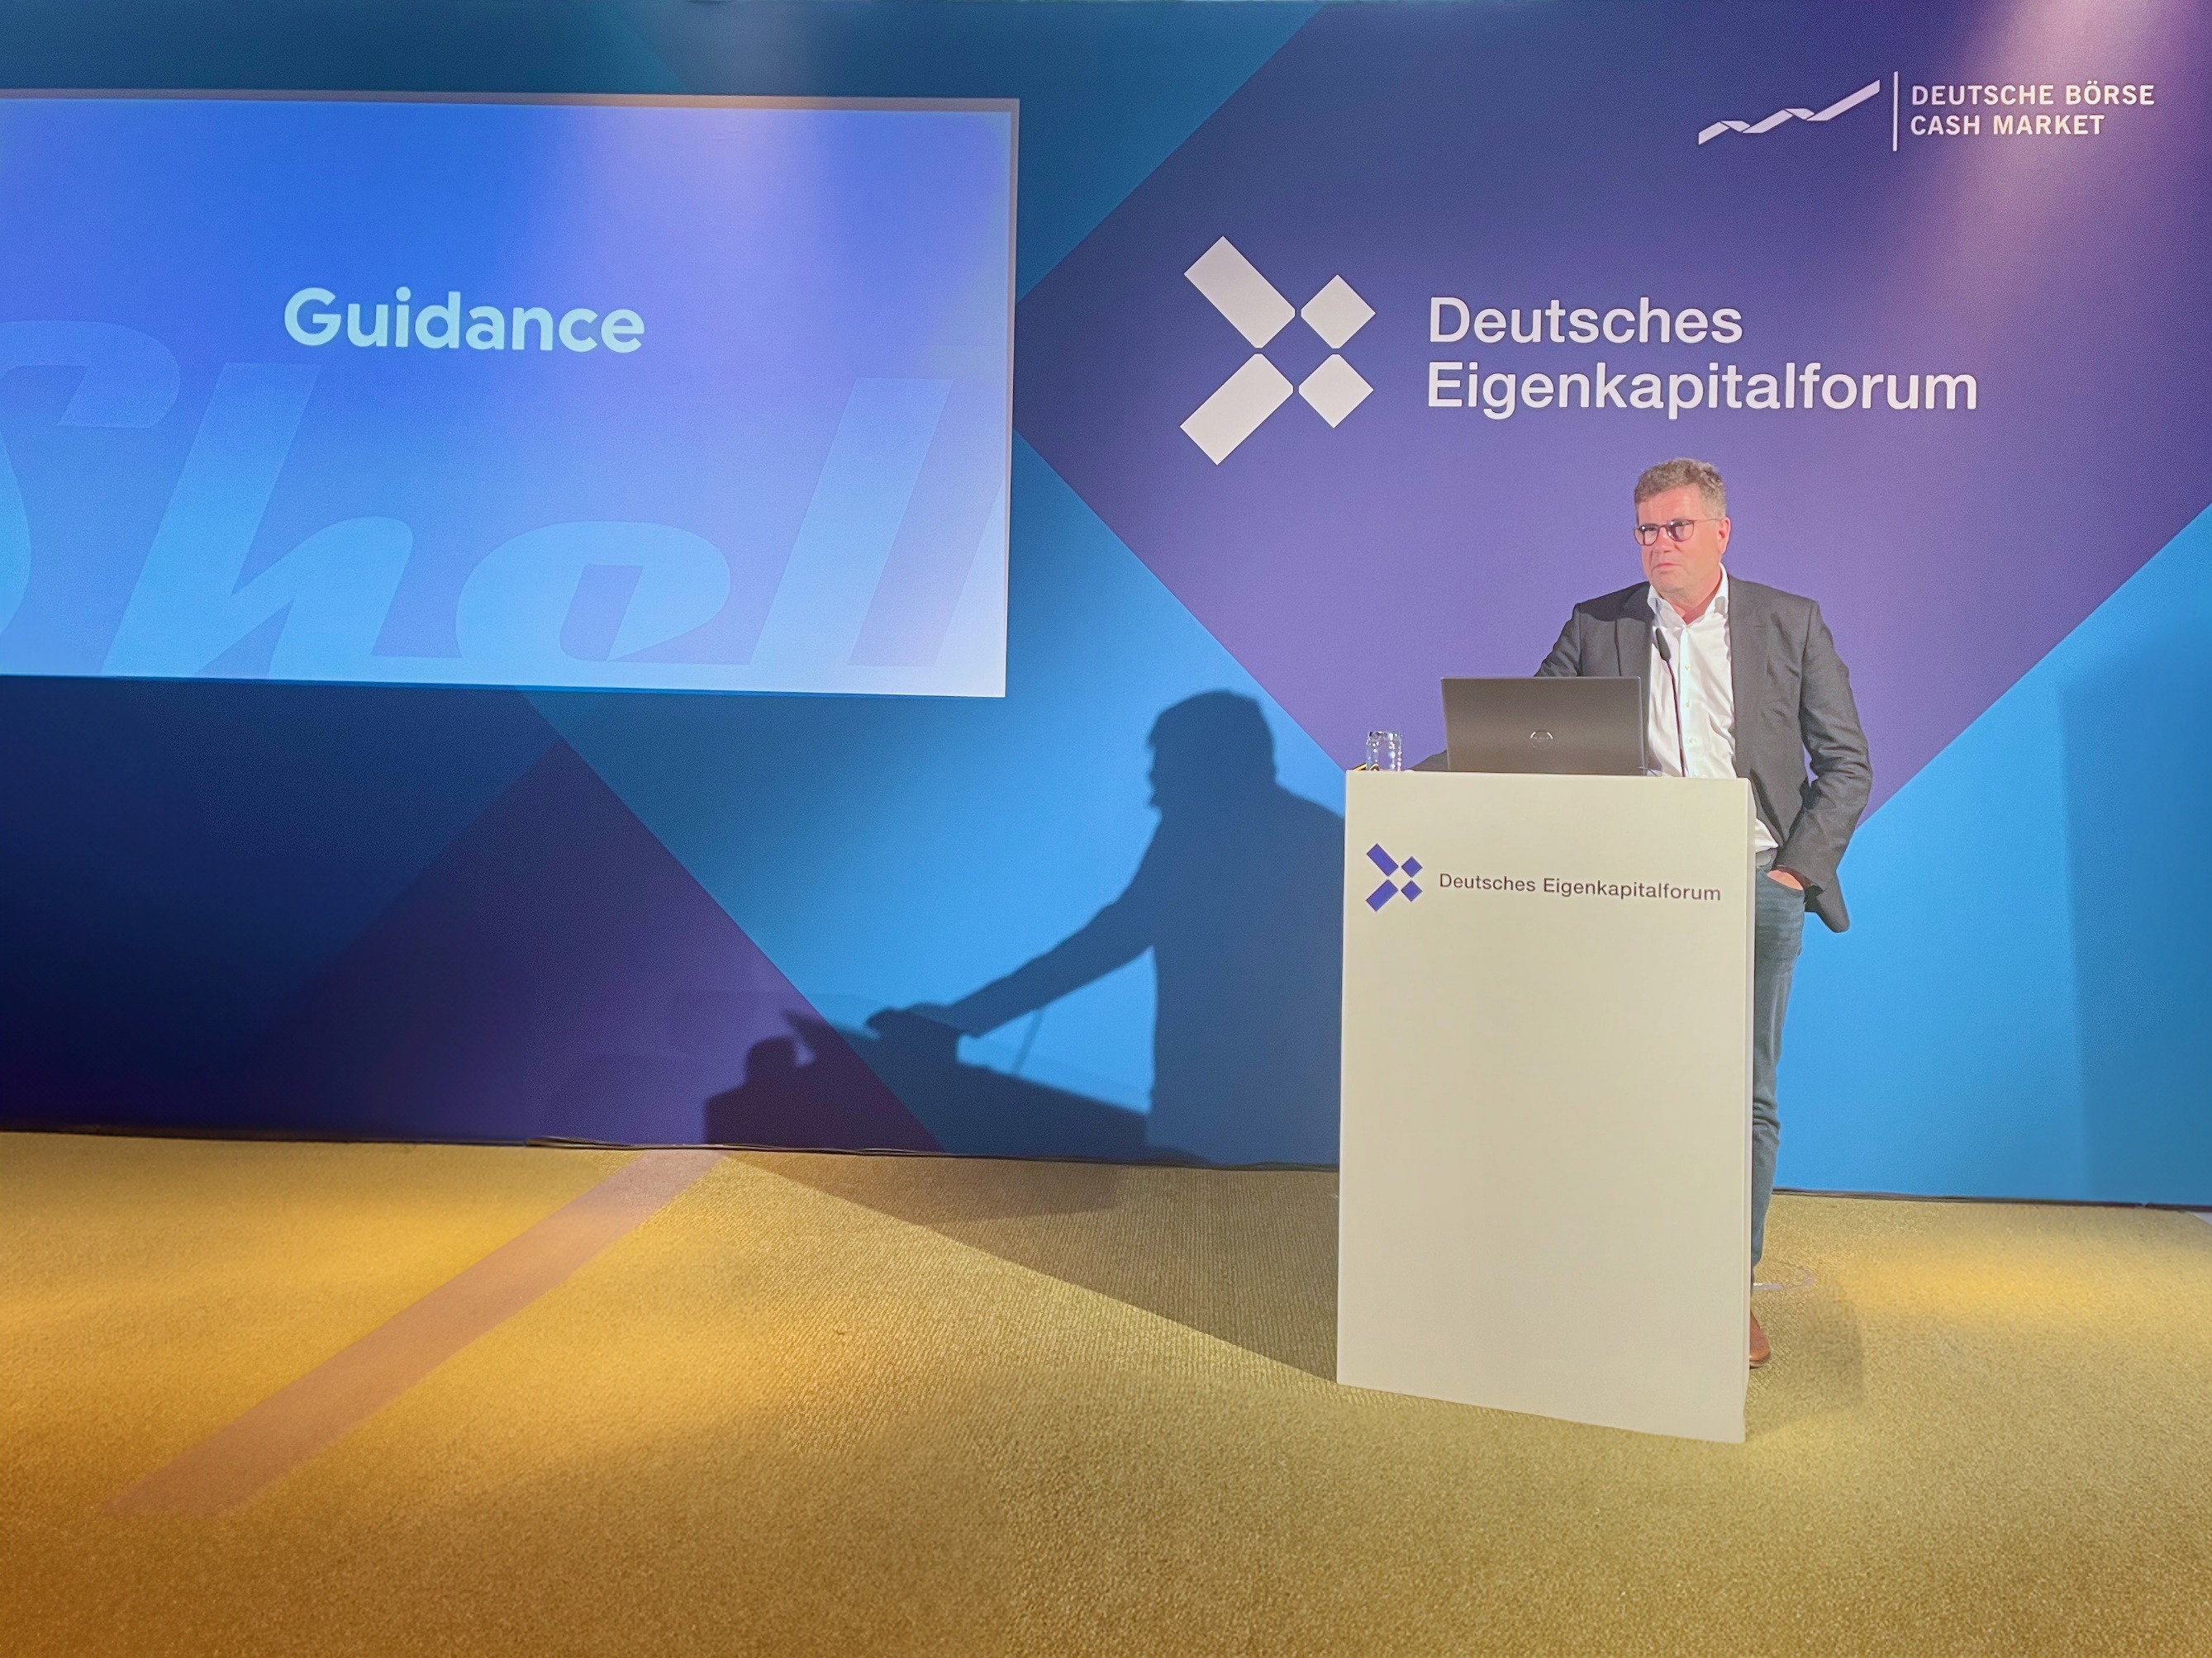
Visibility
Introducing quarterly earning calls, attending investors summits and road shows is essential to making the company known by the investors, and the public.

Slide 94
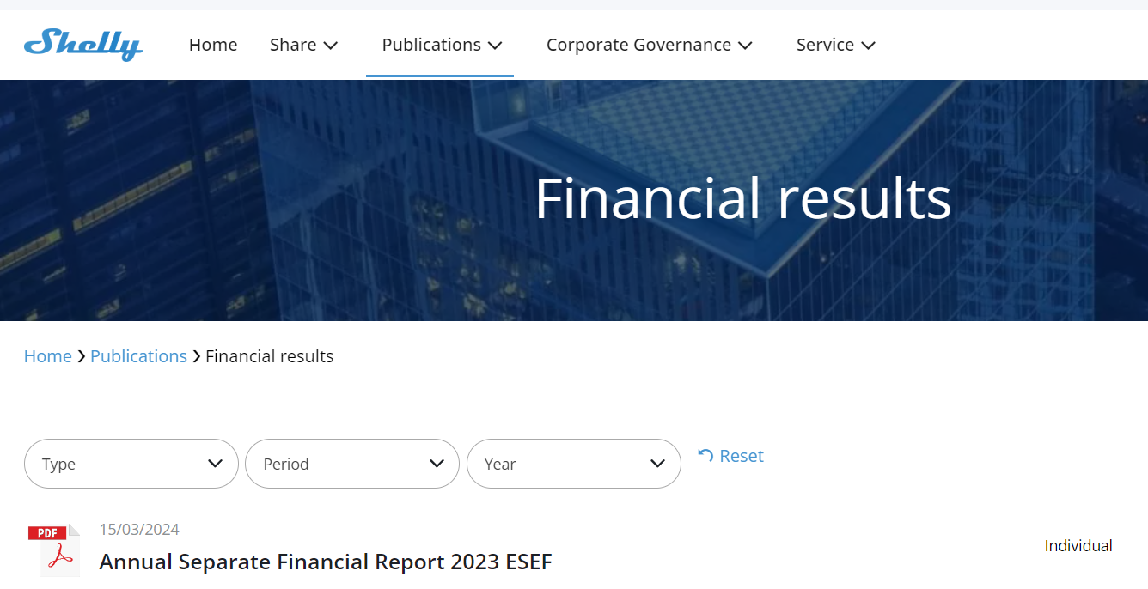
Precise reporting
Publishing relevant corporate news, announcements and solid financial reporting to strengthen strategic investment opportunities.

Slide 95
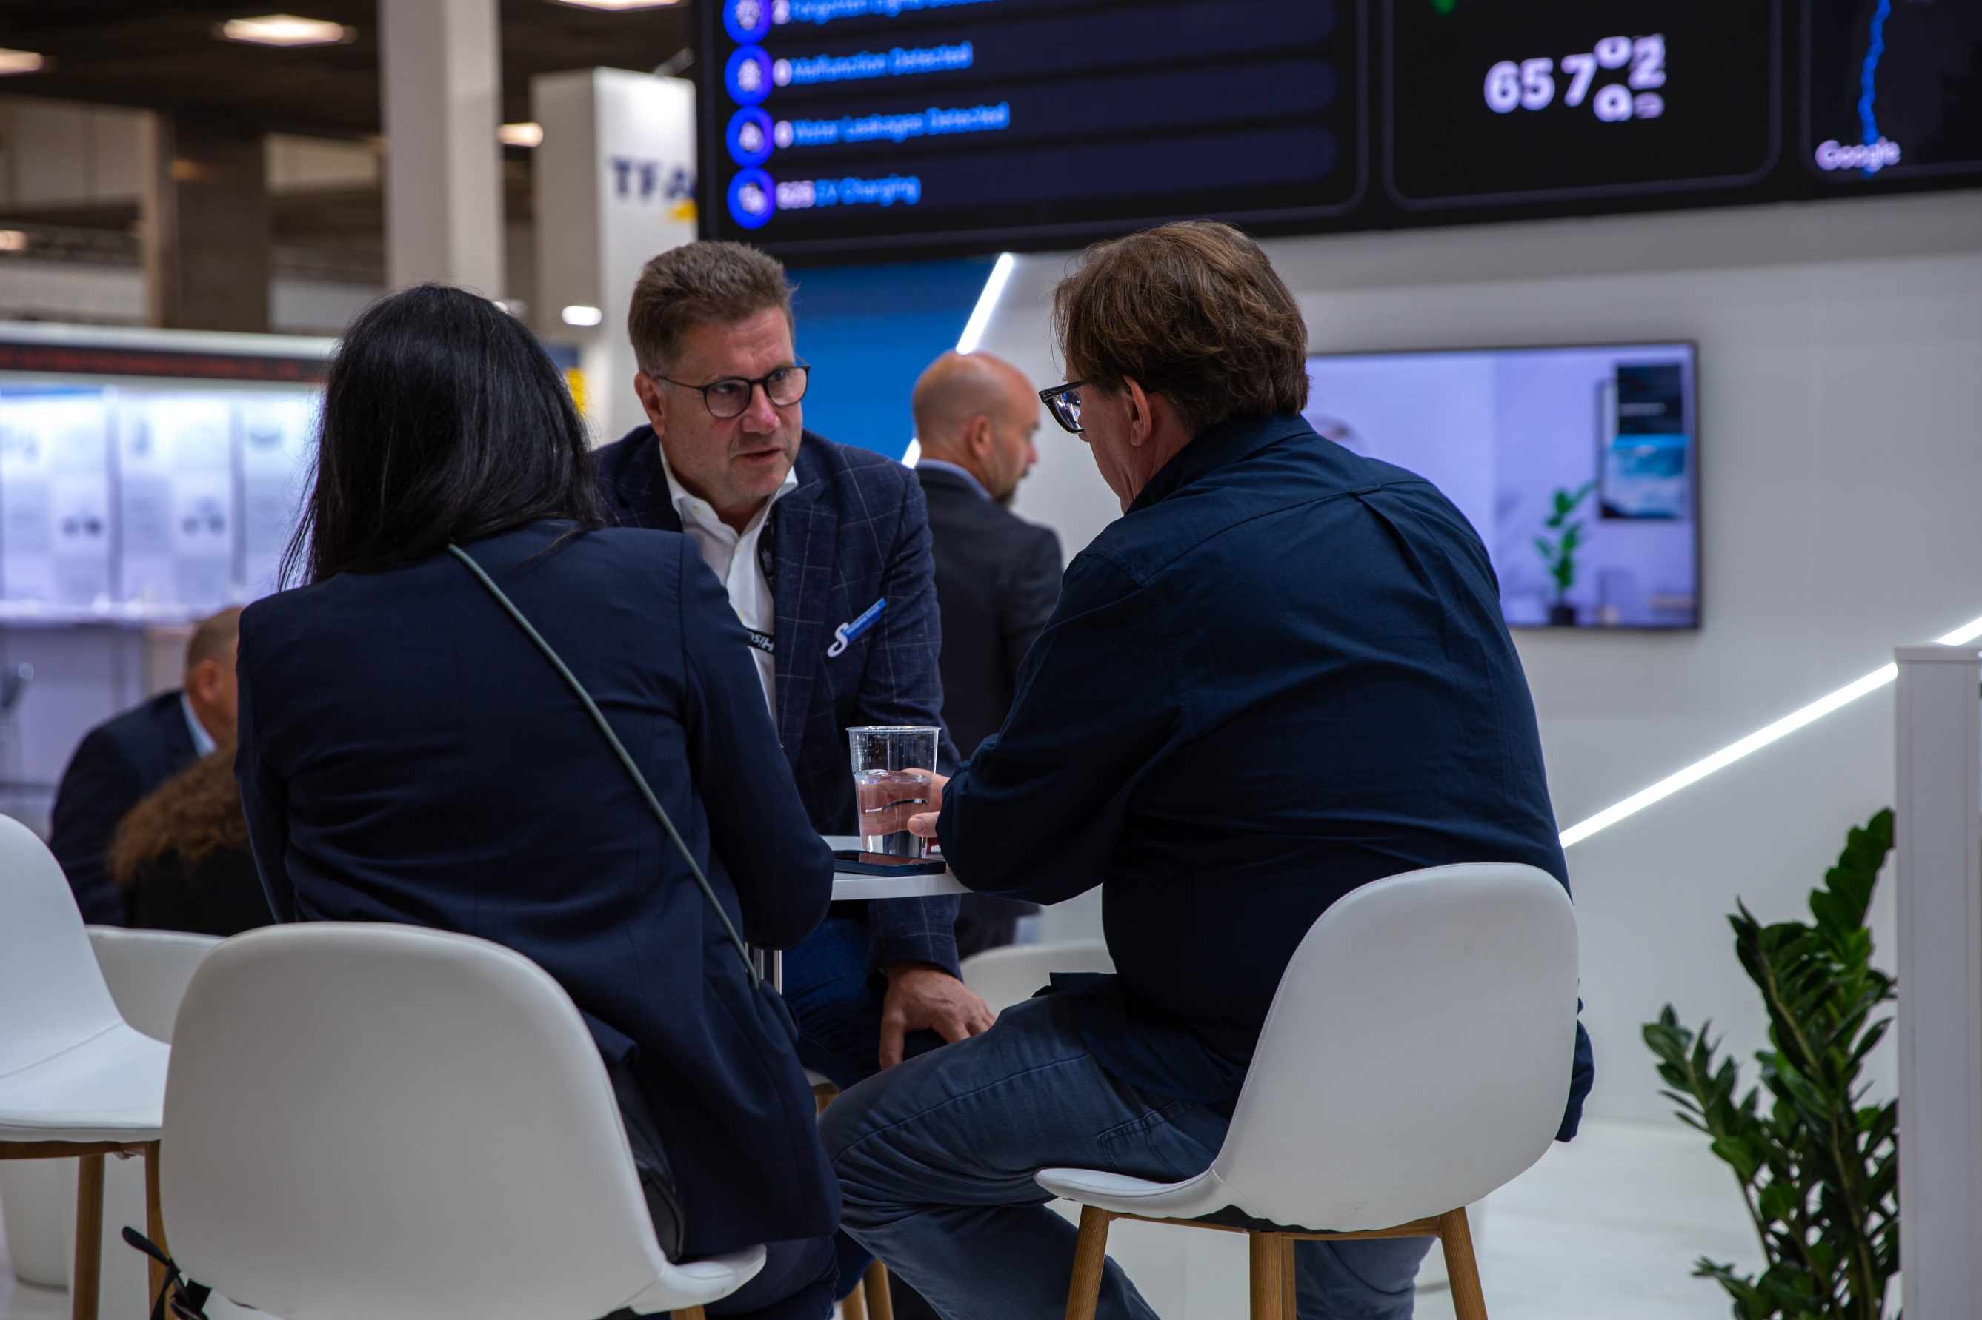
Time – the rule of 7
Do not expect miracles just because your numbers are outstanding. It takes more than one meeting to convince.

Slide 96

Resources
The additional costs for being listed on Frankfurt Stock Exchange include spending approximately 200 000 EUR on one-time expense
and approximately 200 000 – 250 000 EUR additional annual cost.
Be prepared to allocate extra resources.

Slide 97
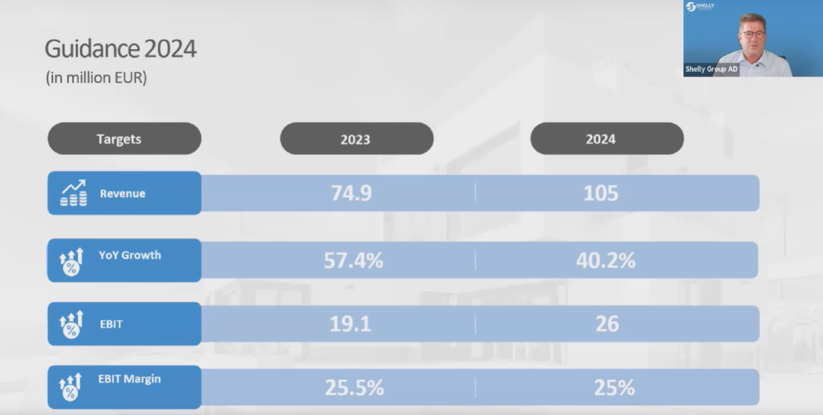
Build trust – promise and deliver
Be ambitious, but make sure that you deliver.
Be careful what you say and be relevant.

Slide 98
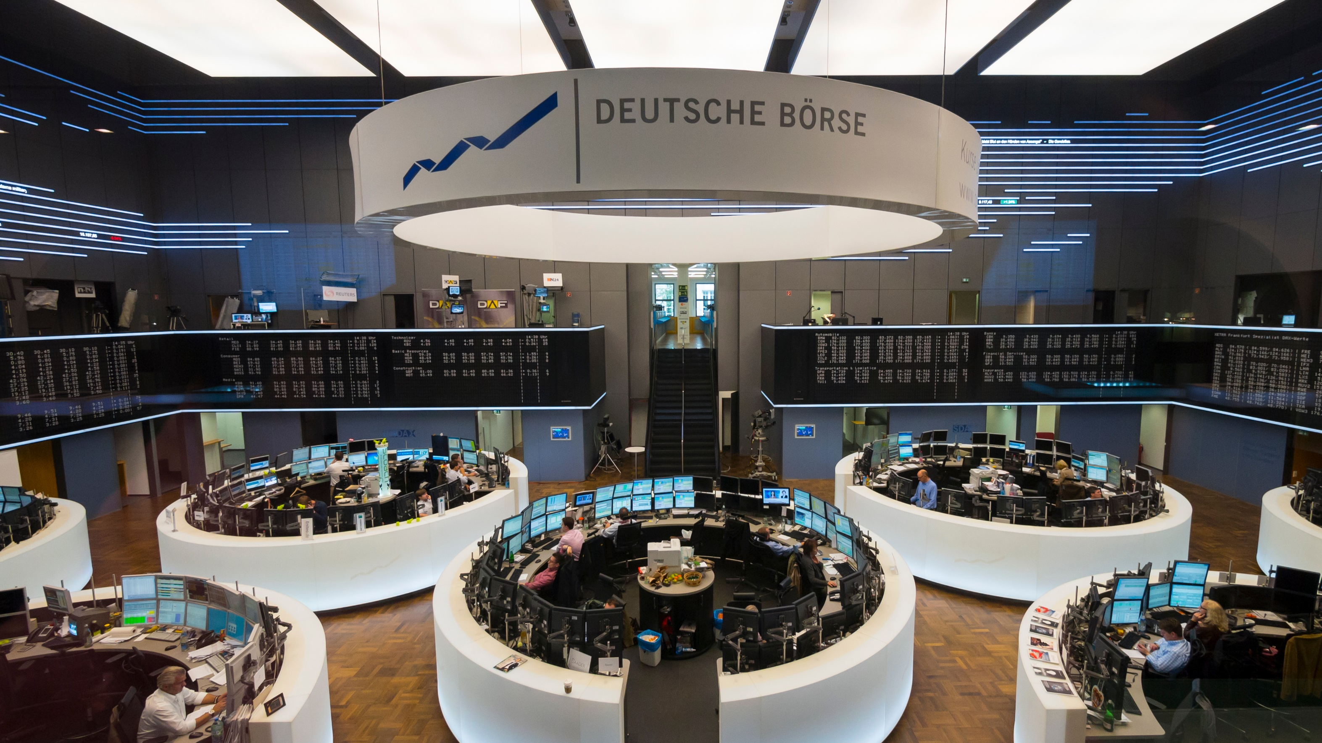
Professional advisors
Adding strategic partners to your team to streamline the process – advisors, legal, corporate relations, impeccable financial team, staff to make sure that the company covers both BSE and FSE regulations.

Slide 99

2023
2024
22/11/2021
Price share when Shelly Group enters Frankfurt Stock Exchange
In 2024:
- 4 quarterly earnings calls
- 5 investors conferences
- 4 roadshows
  2022
  2021
In 2022:
- 4 quarterly earnings calls
- 3 investors conferences
In 2023:
- 4 quarterly earnings calls
- 7 investors conferences
- 5 roadshows
*Data from BSE on Shelly Group AD rounded stock price on closing
Q4 2021
Q1 2022
Q2 2022
Q3 2022
Q4 2022
Q1 2023
Q2 2023
Q3 2023
Q4 2023

Slide 100



The next level - Xetra
Tradability
Volume
Stability
For the majority of investors in Germany a listing on Xetra is mandatory.
Expectations after listing on Xetra is an increase of the trading volume by 4x.
Different from the „standard“ Frankfurt Stock Exchange, Xetra shows the whole depth of the orderbook. That avoids big ups and downs of the share price with smallest volumes.

Slide 101
Appendix - Notice to reporting
The following presentation, including any printed or electronic copy of these slides, the talks given by the presenters, the information communicated during any delivery of the presentation and any question and answer session and any document or material distributed at or in connection with the presentation (together, the “Presentation”), has been prepared by Shelly Group AD (the “Company”), is not an offer to sell any securities or an invitation to purchase securities or the solicitation of an offer to buy securities. This Presentation is not an advertisement and not a prospectus for the purposes of Regulation (EU ) 2 017/1129 of the European Parliament and of the Council of June 14, 2017, as amended.
The Presentation is provided for general information only and does not purport to contain all the information that may be required to evaluate the Company. The information in the Presentation is subject to updating, completion, revision and verification.
No reliance may be placed for any purpose whatsoever on the information or opinions contained or
expressed in the Presentation or on the accuracy, completeness or fairness of such information and opinions. To the extent permit ed by law and regulation, no undertaking, representation or warranty or other assurance, express or implied, is made or given by or on behalf of the Company, or any of its parent or subsidiary undertakings or the subsidiary undertakings of any such parent
undertakings or any of its respective directors, officers, partners, employees, agents, affiliates,
representatives or advisers, or any other person, as to the accuracy, completeness or fairness of the information or opinions contained in the Presentation.
None of the Company, its affiliates and advisers, agents and/or any other party undertakes or is under any duty to update the Presentation or to correct any inaccuracies in any such information which may become apparent or to provide you with any additional information. Save in the ca se of fraud, no responsibility or liability is accepted by any such person for any errors, omissions or inaccuracies in such information or opinions or for any loss, cost or damage suffered or incurred,
however, arising, directly or indirectly, from any use of, as a result of the reliance on, or otherwise in
connection with, the Presentation. In addition, no duty of care or otherwise is owed by any such person to recipients of the Presentation or any other person in relation to the Presentation.
The Presentation includes statements that are, or may be deemed to be, forward looking statements. These statements are based on the current views, expectations and assumptions of the management of the Company and involve known and unknown risks and uncertainties that could cause actual results, performance or events to differ materially from those expressed or implied in such statements. Actual results, performance or events may differ materially from those described in such statements due to, among other things, changes in the general economic and competitive environment, risks associated with capital markets, currency exchange rate fluctuations and competition from other companies, changes in international and national laws and regulations, in particular wit h respect to tax laws and regulations, affecting the Company and other factors. The Company does not assume any obligations to update any forward-looking statements.
The presentation includes statistics, data and other information relating to markets, market sizes, market shares, market positions and other industry data pertaining to the Company's business and markets. Unless otherwise indicated, such information is based on analysis by the Company of multiple sources, including certain studies commissioned from third parties (the “Market Repots”). The Market Repots may include and be based on, amongst other things, information obtained from primary interviews and field visits conducted by third parties with industry experts and participants, third parties’ secondary market research and intern al financial and operational information supplied by, or on behalf of, the Company, as well as information obtained from (i) data providers; (ii) industry association s and country organizations; and (iii) publicly available information from other sources, such as information publicly released by the Company’s competitors. To the extent available, the industry, market and competitive position data contained in the Presentation has come from official or third-party sources. Third party industry publications, studies and surveys generally state that the data contained in them have been obtained from sources believed to be reliable, but that there is no guarantee of the accuracy or completeness of such data. While the Company believes that each of these publications, studies and surveys has been prepared by a reputable source , the Company has not independently verified the data contained therein. In addition, certain of the industry, market and competitive position data contained in the Presentation come from the Company’s own internal research and estimates based on the knowledge and experience of the Company’s management in the markets in which the Company operates. While the Company believes that such research and estimates are reasonable and reliable, they, and their underlying methodology and assumptions, have not been verified by any independent source for accuracy or completeness and are subject to change without notice. Accordingly, undue reliance should not be placed on any of the industry, market or competitive position data contained in the Presentation. All projections, valuations and statistical analyses are provided to assist the recipient in the evaluation of the matters described in the Presentation. They may be based on subjective assessments and assumptions and may use one among alternative methodologies that produce different results and, to the extent that they are based on historical information, they should no t b e relied upon as an accurate prediction of future performance.
The distribution of this Presentation in certain jurisdictions is restricted by law. Therefore, it must not be distributed, published or reproduced (in whole or in pat) or disclosed by its recipients to any other person for any purpose, other than with the consent of the Company. All trademarks remain the property of their respective owners. By accepting receipt of, a ending any delivery of, or electronically accessing, the Presentation, you agree to be bound by the above limitations and conditions and, in particular, you represent, warrant and undertake to the Company that: (i) you will not forward the Presentation to an y other person or reproduce or publish this document, in whole or in pat, for any purpose; and (ii) you have read and agree to comply with the contents of this notice.

Slide 103
Thank you!

